Slide 1
Public Health Project
Backup Slides
College of Health Sciences
Interdisciplinary Health Sciences Ph.D. Program
Public Health Data Management (5357)
Instructor: Dr Amy Wagler, PhD
Richard P. Petri, Jr., MD, FAAPMR
May 2, 2025

Slide 2
DESCRIPTION OF DATA SOURCE AND SAMPLE POPULATION
Title of Study or Project:
The Military Health and Well-Being Project 2020 (MHWP) from the online repository, ICPSR Michigan
Purpose for the data collection:
The purpose of the study was to collect information regarding psychosocial antecedents of health and wellness, including military identity, self-stigma, daily stress, combat exposure, purpose and value, substance use, traumatic brain injury, moral injury, suicide risk, social integration and contribution, and six of eight Substance Abuse and Mental Health Services Administration (SAMHSA) dimensions of wellness (social, emotional, spiritual, intellectual, physical, and environmental components for this study).
Agency: North Carolina State University 2019 Non-Laboratory Research Scholarship Program.
Principal Investigator (PI)/Funder:
Sarah L. Desmarais
Website address:
https://www.icpsr.umich.edu/web/ICPSR/studies/38304

Slide 3
DESCRIPTION OF DATA SOURCE AND SAMPLE POPULATION
The process of gaining access to the dataset:
UTEP belongs to the international consortium ICPSR Michigan, an online repository of open-source datasets. The keywords “well-being,” “military service,” and “veteran” were used to identify the dataset.
Study Participants:
Veterans of the US military who served post-Vietnam, aged 18 and older at the time of data collection, who resided in the United States. Qualtrics Panels service was used for data collection. Black and female veterans were oversampled since these groups have been historically under-represented in veteran studies (Schafer, 2024).
Sample Size (n): 1,495 ​
Year data was collected: 2020

Slide 4
MULTIPLE LINEAR REGRESSION HYPOTHESIS
Protective Factors
H_{o}: Among veterans, the protective factors* are NOT independently associated with alcohol and drug abuse risk.
H_{a}: Among veterans, the protective factors* are independently associated with alcohol and drug abuse risk.
*Calling and Purpose, Community Engagement, Help-Seeking Behaviors, Military Calling, Quality of Life, Public Service Motivation, and Overall Wellness.

Slide 5
MULTIPLE LINEAR REGRESSION HYPOTHESIS
Risk Factors
H_{o}: Among veterans, the risk factors* are NOT independently associated with alcohol and drug abuse risk.
H_{a}: Among veterans, the risk factors* are independently associated with alcohol and drug abuse risk.
**Combat Exposure, Daily Stress Status, Loneliness Level, Degree of Moral Injury, Self-Stigmatization Level, Suicide Risk Status, and History of Traumatic Brain Injury.

Slide 6
MULTIPLE LINEAR REGRESSION HYPOTHESIS
Buffering Effect
H_{o}: Among veterans, the protective* do not buffer the risk factors** associated with alcohol and drug abuse risk.
H_{a}: Among veterans, the protective factors* do buffer the risk factors** associated with alcohol and drug abuse risk.
*Protective Factors = Calling and Purpose, Community Engagement, Help-Seeking Behaviors, Military Calling, Quality of Life, Public Service Motivation, and Overall Wellness.
**Risk Factors = Combat Exposure, Daily Stress, Loneliness, Moral Injury, Self-Stigmatization, Suicide Risk, and History of Traumatic Brain Injury

Slide 7
MULTIPLE LINEAR REGRESSION
Research Aims
What is the association of protective* and risk factors** with alcohol abuse and drug risk use among US Veterans?
What is the buffering effect of protective factors* on the risk factors** related to alcohol and drug abuse risk in US Veterans?
When evaluating all the factors simultaneously, which construct accounts for the greatest variability in alcohol and drug abuse risk, an exploratory approach?
*Protective Factors = Calling and Purpose, Community Engagement, Help-Seeking Behaviors, Military Calling, Quality of Life, Public Service Motivation, and Overall Wellness.
**Risk Factors = Combat Exposure, Daily Stress, Loneliness, Moral Injury, Self-Stigmatization, Suicide Risk, and History of Traumatic Brain Injury

Slide 8
MULTIPLE LINEAR REGRESSION HYPOTHESIS
Assumptions And Missing Values
Variables —The dataset variables used in this project were all composite, scalable variables derived from the summation of the related metrics questions. Within the analysis, the composite variables were used in their continuous state. This is a reasonable assumption since the overall scores measure the degree of the screening tools. The exceptions are the nominal variable RACE, the binary variable TBI, and the continuous variables AGE and INCOME.
Confounders – Age, gender, race, and socioeconomic status (proxy is income) are known confounders for alcohol and drug abuse risk and are used in the modeling (Brown 1995).
Income – Based on the IQR rule, there were 56 outliers. Descriptive Statistics included analysis with and without outliers. The data without outliers was used for analysis.

Slide 9
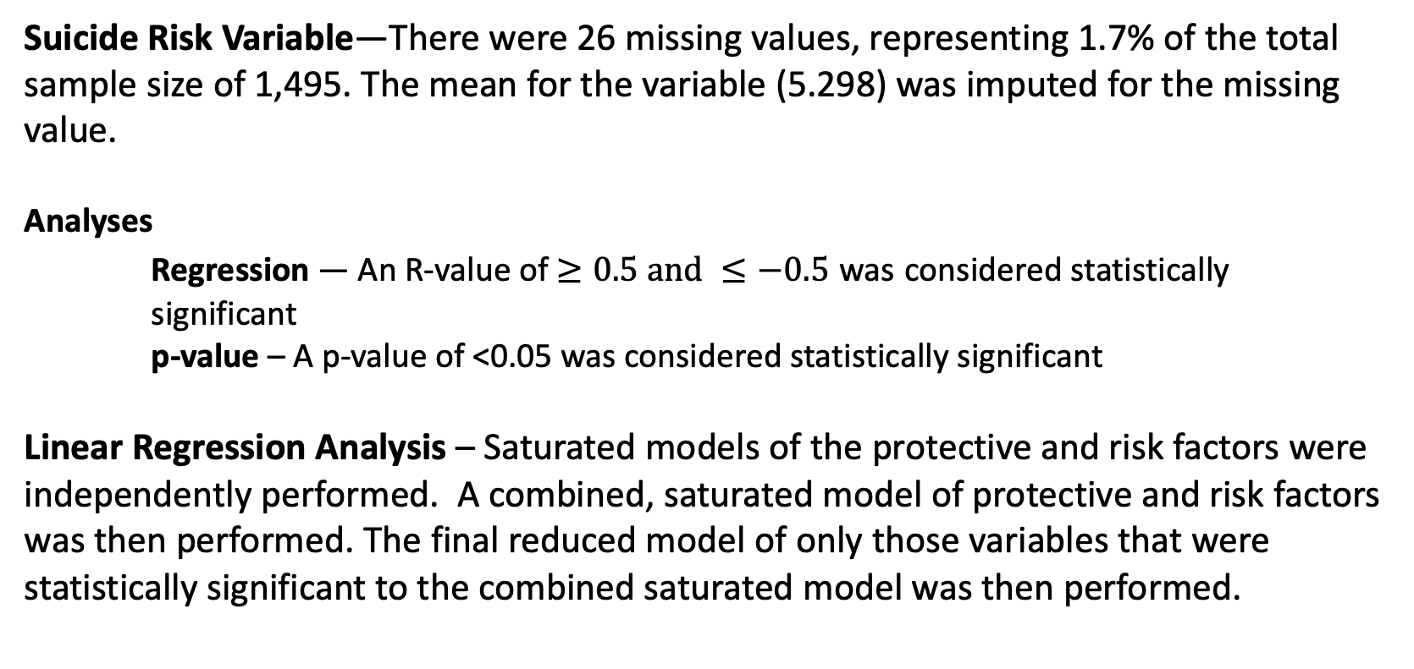
MULTIPLE LINEAR REGRESSION HYPOTHESIS
Assumptions And Missing Values
Suicide Risk Variable—There were 26 missing values, representing 1.7% of the total sample size of 1,495. The mean for the variable (5.298) was imputed for the missing value.
Analyses
Regression — An R-value of $≥0.5 and ≤−0.5$ was considered statistically significant
p-value – A p-value of <0.05 was considered statistically significant
Linear Regression Analysis – Saturated models of the protective and risk factors were independently performed. A combined, saturated model of protective and risk factors was then performed. The final reduced model of only those variables that were statistically significant to the combined saturated model was then performed.

Slide 10
Variables

Slide 11
MULTIPLE LINEAR REGRESSION
Data Management
Dependent Variable | Units/Levels/Missing Values Code
Y: Alcohol and Drug Abuse Risk (Continuous) (CAGEAID_TOTAL) CAGEAID_TOTAL is the summation of CAGEAID_1 through CAGEAID_5 | Units/Range (Min, Max): Scale /4 (0,4) Missing Values None

Slide 12
MULTIPLE LINEÅR REGRESSION
Data Management
Independent Variables (Protective Behaviors) | Units/Levels/Missing Values Code
X_{P1}: Calling and Purpose (Continuous) (PUR_TOTAL) Recoded from the summation of PURPOSE_1 through PURPOSE_5 | Units/Range (Min, Max): Scale /20 (5,25) Missing Values None
X_{P2}: Community Engagement (Continuous) (SOC_TOTAL) Recoded from (SOC_TOTAL = SOC_INT_TOTAL + SOC_CON_TOTAL) (SOC_INT_TOTAL = SOC_INTEGRATION_1R, + 2 +3) (SOC_CON_TOTAL =SOC_CONTRIBUTION_1 + 2R + 3R) | Units/Range (Min, Max): Scale / 24 (12, 36) Missing Values None

Slide 13
MULTIPLE LINEAR REGRESSION
Data Management
Independent Variables (Protective Behaviors) | Units/Levels/Missing Values Code
X_{P3}: Help-seeking Behaviors (Continuous) (HELP_TOTAL) Recoded from summation of HELP_SEEKING_1 through HELP_SEEKING_3 | Units/Range (Min, Max): Years / 18 (3, 21) Missing Values None
X_{P4}: Military Calling (Continuous) (MIL_CALL) Recoded from summation of NPIS_1 through 3 | Units/Range (Min, Max): Years /18 (3, 21) Missing Values None

Slide 14
MULTIPLE LINEAR REGRESSION
Data Management
Independent Variables (Protective Behaviors) | Units/Levels/Missing Values Code
X_{P5}: Quality of Life (Continuous) (WHO_TOTAL) Recoded from WHO1 through WHO26 with reverse codes for (3R, 4R, and 26R). | Units/Range (Min, Max): Scale / 104 (26, 130) Missing Values None
X_{P6}: Public Service Motivation (Continuous) (PUB_SER) Recoded from the summation of PUBLIC_1 through PUBLIC_5 | Units/Range (Min, Max): Scale / 20 (5, 25) Missing Values None

Slide 15
MULTIPLE LINEAR REGRESSION
Data Management
Independent Variables (Protective Behaviors) | Units/Levels/Missing Values Code
X_{P7}: Overall Wellness Level (WELL_MAG) Recoded from WELLNESS_1 through 30 with reverse codes for 2, 6, 8, 9, 10, 12, 14, 17, 21, 23, 24, 26, 30. | Units/Range (Min, Max): Scale / 110 (40, 150 ) Missing Values None

Slide 16
MULTIPLE LINEAR REGRESSION
Data Management
Independent Variables (Risk Factors) | Units/Levels/Missing Values Code
X_{N1}: Combat Exposure (Continuous) (COM_TOTAL) Recoded COM_TOTAL = Summation of CES_1 through CES_7 | Units/Range (Min, Max): Scale / 28 (7, 35) Missing Values None
X_{N2}: Daily Stress (Continuous) (STRESS_TOTAL) Recoded STRESS_TOTAL as summation of STRESS_1 through STRESS_7 | Units/Range (Min, Max): Scale / 7 (0, 7) Missing Values None

Slide 17
MULTIPLE LINEAR REGRESSION
Data Management
Independent Variables (Risk Factors) | Units/Levels/Missing Values Code
X_{N3}: Loneliness (Categorical) (LONE_TOTAL) Recoded LONE_TOTAL from summation of LONELINESS_1 through LONLINESS_3 | Units/Range (Min, Max): Scale / 6 (3, 9) Missing Values None
X_{N4}: Moral Injury (Categorical) (MOR_INJ) Recoded MOR_INJ from the summation of MISSSF_1 through MISSSF_11 using reverse for 5R, 6R, 7R, 9R and 10R. | Units/Range (Min, Max): Scale / 87 (11, 98) Missing Values None

Slide 18
MULTIPLE LINEAR REGRESSION
Data Management
Independent Variables (Risk Factors) | Units/Levels/Missing Values Code
X_{N5}: Self-Stigma (Continuous) (STIGMA) Recoded from the summation of DD_1 through DD_4 | Units/Range (Min, Max): Scale / 24 (4, 28) Missing Values None
X_{N6}: Suicide-Risk Status(Binary) (SUICIDE_TOTAL) Recoded SUICIDE_TOTAL = the summation of SBQ_1 through SBQ_4 | Units/Range (Min, Max): Scale / 28 (7, 35) Missing Values There are 26 missing values (1.7%) The mean was imputed for the missing values.

Slide 19
MULTIPLE LOGISTIC REGRESSION
Data Management
Independent Variables (Risk Factors) | Units/Levels/Missing Values Code
X_{N7}: History of Traumatic Brain Injury (TBI) (TBI) | Levels / Coding: 0 No 1 Yes

Slide 20
MULTIPLE LINEÅR REGRESSION
Data Management
Confounding Variables (Brown, 1995) | Units/Levels/Missing Values Code
X_{C1}: Age (Continuous) (AGE) | Units/Range (Min, Max): Years / 68 (18,86) Missing Values None
X_{C2}: Gender (Categorical – three levels) (GENDER) | Levels 1 Male 2 Female 3 Other Missing Values None

Slide 21
MULTIPLE LINEÅR REGRESSION
Data Management
Confounding Variables (Brown, 1995) | Units/Levels/Missing Values Code
X_{C1}: Race (Categorical – 6 levels) (RACE_R) Recoded to 2 levels White and Non-White. White includes Hispanics. | Levels 1 White 2 Non-White
X_{C2}: Income (Continuous) (INCOME_WO) Recoded to INCOME_WO from INCOME with the removal of the 56 outliers | Units/Range (Min, Max): $ USD / 24 (0, 200,000) Missing Values None

Slide 22
Results

Slide 23
DESCRIPTIVE STATISTICS
The 2022 Military Health and Well-Being Project from ICPSR Michigan (N=1,495)
Table 3 Descriptive Statistics for Dataset Variables | N | Median (Q1, Q3) | Frequency (%)
Age (years) | 1495 | 68.0 (18.0, 86.0)
Branch
Air Force/Air Force Reserve |  |  | 366 (24.5%)
Air National Guard |  |  | 36 (2.4%)
Army/Army Reserve |  |  | 491 (32.8%)
Army National Guard |  |  | 115 (7.7%)
Coast Guard/Coast Guard Reserve |  |  | 42 (2.8%)
Marine Corps/Marine Corps Reserve |  |  | 122 (8.2%)
Navy/Navy Reserve |  |  | 323 (21.6%)
Employed | 1495
No |  |  | 604 (40.4%)
Yes |  |  | 891 (59.6%)
Gender | 1495
Male |  |  | 1004 (67.2%)
Female |  |  | 483 (32.3%)
Other |  |  | 8 (0.5%)
Income with outliers (USD) | 1495 | $60,000 ($0.0, $1.5M)
Income without outliers (USD) | 1495 | $59, 000 ($0.0, $200,000)
Length of Service (years) | 1495 | 6.0 (0.03, 40.0)
Marital Status | 1495
Single |  |  | 282 (18.9%)
Married |  |  | 886 (59.3%)
Domestic Partnership |  |  | 73 (4.9%)
Divorced |  |  | 211 (14.1%)
Widowed |  |  | 43 (2.9%)
Race | 1495
White |  |  | 1129 (75.5%)
Black |  |  | 215 (14.4%)
Hispanic |  |  | 86 (5.8%)
Asian |  |  | 42 (2.8%)
American Indian/Alaska Native |  |  | 13 (0.9%)
Native Hawaiian/Other Pacific Islander |  |  | 10 (0.7%)
Region
Southeast |  |  | 507 (33.9%)
Northeast |  |  | 262 (17.5%)
Midwest |  |  | 272 (18.2%)
West |  |  | 295 (19.7%)
Southwest |  |  | 159 (10.7%)
Number of Years Since Discharge from 2022 (years) | 1495 | 21.0 (0.0, 45.0)

Slide 24
MULTIPLE LINEAR REGRESSION HYPOTHESIS
Models used in the Analysis
Table 1
Protective Factors Models
model1 Protective Factors – saturated
model2 Protective Factors – reduced (only statistically significant model1, backup slides)
Risk Factors Model
model3 Risk Factors – saturated
Combined Factors Models
model5 Combined model of protective and risk factors (backup slides)
model6 model5 adjusted for confounders of age and race
Models Adjusted for the Confounders (Age, Gender, Race, Income)
model1a Protective Factors – saturated, adjusted for confounders (Age, Gender, Race, Income)
model3a Risk Factors – saturated, adjusted for confounders (Age, Gender, Race, Income)
model5a Combined model of protective and risk factors, adjusted for confounders (Age, Gender, Race, Income) – saturated
model6a model6 reduced (only statistically significant factors of model6)

Slide 25
MULITPLE LINEAR REGRESSION SUMMARY TABLES
Table 2 Comparative Chart of the ß Coefficients Protective and Risk Factors Independently Associated with Alcohol and Drug Abuse Risk using Multiple Linear Regression among Veterans in The 2022 Military Health and Well-Being Project from ICPSR Michigan (N=1,495)
Measures | Model 1 | Model 2 | Model 1a | Model 3 | Model 3a | Model 5 | Model 6 | Model 5a | Model 6a
 | ß | ß | ß | ß | ß | ß | ß | ß | ß
Constant | 2.999 | 3.358 | 3.609 | -0.787 | -0.403 | -1.109 | -1.27 | -0.726 | -0.2042
Calling and Purpose | 0.011 |  | 0.019 |  |  | 0.020 | 0.018 | 0.016
Community Engagement | 0.001 |  | -0.004 |  |  | 0.001 | 0.001 | 0.002
Help-Seeking Behavior | 0.031 | 0.036 | 0.017 |  |  | 0.014 | 0.014 | 0.015
Military Calling | -0.020 |  | -0.008 |  |  | 0.004 | 0.005 | 0.003
Quality of Life | -0.013 | -0.014 | -0.016 |  |  | -0.001 | -0.001 | -0.002
Public Service Motivation | 0.021 |  | 0.016 |  |  | -0.005 | -0.004 | -0.002
Overall Wellness | -0.016 | -0.015 | -0.010 |  |  | -0.001 | -0.001 | -0.000
Combat Exposure |  |  |  | 0.015 | 0.012 | 0.014 | 0.014 | 0.011
Daily Stress |  |  |  | 0.121 | 0.129 | 0.115 | 0.116 | 0.124 | 0.134
Loneliness |  |  |  | 0.054 | 0.052 | 0.049 | 0.049 | 0.048 | 0.053
Moral Injury |  |  |  | 0.014 | 0.013 | 0.014 | 0.014 | 0.013 | 0.014
Self-Stigmatization |  |  |  | 0.004 | 0.001 | 0.007 | 0.007 | 0.004
Suicide Risk |  |  |  | 0.076 | 0.081 | 0.075 | 0.075 | 0.081 | 0.082
History of Traumatic Brain Injury |  |  |  | 0.014 | 0.011 | 0.018 | 0.023 | 0.014
Confounders
Age |  |  | 0.015 |  | -0.001 |  | 0.001 | -0.000 | -0.003
Gender (Male vs. Female vs. Other) |  |  | -0.223 |  | -0.027 |  | 0.106 | 0.271 | -0.029
Race (White vs. Non-white) |  |  | 0.196 |  | 0.151 |  |  | 0.139 | 0.161
Income |  |  | <0.001 |  | <0.001 |  |  | <0.001 | <0.001
Correlations/Model p-value/ Greatest Contributor to the Model
R Correlation | 0.381 | 0.374 | 0.414 | 0.491 | 0.512 | 0.518 | 0.519 | 0.518 | 0.511
R² % of Variance | 14.5% | 14.0% | 17.1% | 24.1% | 26.2% | 26.8% | 26.9% | 26.8% | 26.0%
p-value | <0.001 | <0.001 | <0.001 | <0.001 | <0.001 | <0.001 | <0.001 | <0.001 | <0.001
Factor Contributing the most to the model | Help-Seeking | Help-Seeking | Calling and Purpose | Daily Stress | Daily Stress | Daily Stress | Daily Stress | Daily Stress | Daily Stress
*Denotes when the p-value < 0.05

Slide 26
MULTIPLE LINEAR REGRESSION HYPOTHESIS
Protective Factors* Model 1a
(adjusted for confounders**)
H_{o}: Among veterans, the protective factors* are NOT independently associated with alcohol abuse risk.
H_{a}: Among veterans, the protective factors* are independently associated with alcohol abuse risk.
Reject the H_{o}
The Protective Factors adjusted for confounders are independently associated with Alcohol and Drug Abuse Risk (p < 0.001).
*Protective Factors = Calling and Purpose, Community Engagement, Help-Seeking Behaviors, Military Calling, Quality of Life Score, Public Service Motivation and Overall Wellness
**Confounding Factors = Age, Gender, Race, and Income (Brown, 1995)

Slide 27
MULTIPLE LINEAR REGRESSION HYPOTHESIS
Risk Factors* Model 3a
(adjusted for confounders**)
H_{o}: Among veterans, the risk factors* are NOT independently associated with alcohol abuse risk.
H_{a}: Among veterans, the risk factors* are independently associated with alcohol abuse risk.
Reject the H_{o}
The Risk Factors adjusted for confounders are independently associated with Alcohol and Drug Abuse Risk (p < 0.001).
* Risk Factors = Combat Exposure, Daily Stress, Loneliness, Moral Injury, Self-Stigmatization, Suicide Risk, and History of Traumatic Brain Injury
**Confounding Factors = Age, Gender, Race, and Income (Brown, 1995)

Slide 28
MULTIPLE LINEAR REGRESSION HYPOTHESIS
Saturated Model 5a Comparision to Models 1a and 3a
Buffering Effect
(adjusted for confounders***)
H_{o}: Among veterans, the protective* do not buffer the risk factors** associated with alcohol abuse risk.
H_{a}: Among veterans, the protective factors* do buffer the risk factors** associated with alcohol abuse risk.
Accept the H_{o}
Since the alcohol and drug abuse risk is primarily attributed to the risk factors without significant change when the protective factors are added, it suggests that the protective factors do not buffer the risk factors associated with alcohol and drug abuse risk.
*Protective Factors = Calling and Purpose, Community Engagement, Help-Seeking Behaviors, Military Calling, Quality of Life, Public Service Motivation, and Overall Wellness.
**Risk Factors = Combat Exposure, Daily Stress, Loneliness, Moral Injury, Self-Stigmatization, Suicide Risk, and History of Traumatic Brain Injury.
***Confounders = Age, Gender, Race, and Income (Brown, 1995)

Slide 29
MULTIPLE LINEAR REGRESSION
Research Aims
What is the association of protective* and risk factors** with alcohol abuse and drug risk use among US Veterans?
There is a correlation between Alcohol and Drug Abuse Risk and combined, saturated model (5a) adjusted for confounding factors (R = 0.5181)
What is the buffering effect of protective factors* on the risk factors** related to alcohol and drug abuse risk in US Veterans?
Since the alcohol and drug abuse risk is primarily attributed to the risk factors
without significant change when the protective factors are added, it suggests that the
protective factors do not buffer the risk factors associated with alcohol and drug abuse
risk.
When evaluating all the factors simultaneously, which construct accounts for the greatest variability in alcohol and drug abuse risk, an exploratory approach?
Daily Stress (0.124)
*Protective Factors = Calling and Purpose, Community Engagement, Help-Seeking Behaviors, Military Calling, Quality of Life, Public Service Motivation, and Overall Wellness.
**Risk Factors = Combat Exposure, Daily Stress, Loneliness, Moral Injury, Self-Stigmatization, Suicide Risk, and History of Traumatic Brain Injury
*** Confounders = Age, Gender, Race, and Income

Slide 30
MULITPLE LINEAR REGRESSION SUMMARY TABLES
Table 3 Protective and Risk Factors Independently Associated with Alcohol and Drug Abuse Risk using Cohen F among Veterans in The 2022 Military Health and Well-Being Project from ICPSR Michigan (N=1,495) (adjusted for confounders)
Variables | Effect Size (sr²) | Interpretation
Calling and Purpose | 0.0083 | Very small
Community Engagement | 0.0002 | Negligible
Help-Seeking Behavior | 0.015 | Small
Military Calling | 0.0003 | Negligible
Quality of Life | 0.0026 | Very small
Public Service Motivation | 0.0001 | Negligible
Overall Wellness | 0.0002 | Negligible
Combat Exposure | 0.0155 | Small
Daily Stress | 0.1541 | Medium to large
Loneliness | 0.0243 | Small
Moral Injury | 0.0773 | Medium
Self-Stigmatization | 0.0016 | Very small
Suicide Risk | 0.2313 | Large
History of Traumatic Brain Injury | 0.0001 | Negligible
Confounders
Age | 0 | Negligible
Gender | 0.0785 | Medium
Race | 0.0151 | Small
Income | 0.0088 | Very small
Variables | Effect Size (sr²) | Interpretation | Variables
Notes:
*

Slide 31
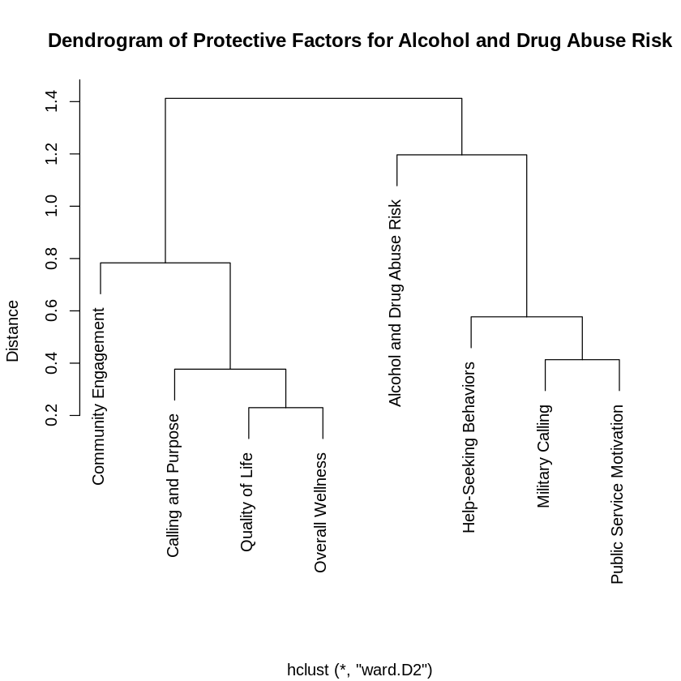
MULTIPLE LINEAR REGRESSION
Dendrogram for Protective Factors
Figure 2
Interpretation Statement The dendrogram suggests there may be collinearity between Quality of Life and Overall Wellness and between Military Calling and Public Service Motivation.

Slide 32
MULITPLE LINEAR REGRESSION Summary Tables
Table 5: Variance Inflation Factors for the Protective Factors* Model among Veterans in The 2022 Military Health and Well-Being Project from ICPSR Michigan (N=1,495)
Measures | Variance Inflation Factors
Calling and Purpose | 1.594
Community Engagement | 2.388
Help-Seeking Behavior | 1.359
Military Calling | 1.531
Quality of Life | 2.628
Public Service Motivation | 2.038
Overall Wellness | 3.385
*Calling and Purpose, Community Engagement, Help-Seeking Behaviors, Military Calling, Quality of Life Score, Public Service Motivation and Wellness
Interpretation Statement The Variance Inflation Factors (VIF) for the Protective Factors for Alcohol and Drug Abuse are below 5. Therefore, it suggests a moderate or low correlation between predictor variables, indicating that multicollinearity is unlikely to significantly impact the regression model. However, the highest VIF value (3.385) suggests some degree of correlation, but it is still within an acceptable range.
Notes:
*

Slide 33
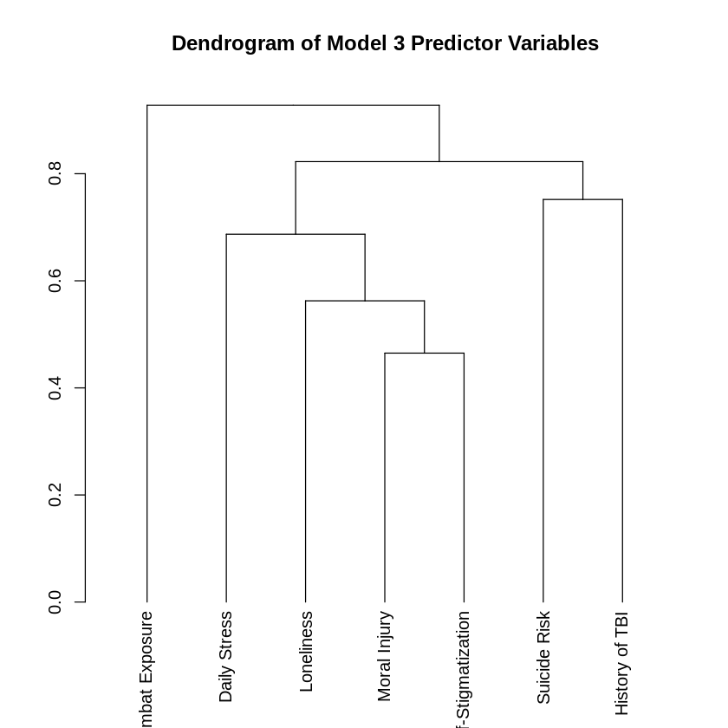
MULTIPLE LINEAR REGRESSION
Dendrogram for Risk Factors
Figure 4
Interpretation Statement The dendrogram suggests there may not be collinearity between the risk factors.

Slide 34
MULITPLE LINEAR REGRESSION Summary Tables
TABLE 8: Variance Inflation Factors for the Risk Factors* among Veterans in The 2022 Military Health and Well-Being Project from ICPSR Michigan (N=1,495)
Measures | Variance Inflation Factors
Combat Exposure | 1.193
Daily Stress | 1.349
Loneliness | 1.472
Moral Injury | 2.052
Self-Stigmatization | 1.299
Suicide Risk | 1.448
History of Traumatic Brain Injury | 1.075
*Combat Exposure, Daily Stress, Loneliness, Moral Injury, Self-Stigmatization, Suicide Risk, and History of Traumatic Brain Injury
Interpretation Statement The Variance Inflation Factors (VIF) for the Risk Factors for Alcohol and Drug Abuse are below 5. Therefore, it suggests a moderate or low correlation between predictor variables, indicating that multicollinearity is unlikely to significantly impact the regression model.
Notes:
*

Slide 35
REFERENCES
Brown, R. L., & Rounds, L. A. (1995). Conjoint screening questionnaires for alcohol and other drug abuse: criterion validity in a primary care practice. Wis Med J, 94(3), 135-140. https://pubmed.ncbi.nlm.nih.gov/7778330/
Schafer, K. M., Melia, R., & Joiner, T. (2024). Risk and protective correlates of suicidality in the Military Health and Well-being Project. Journal of Affective Disorders. https://doi.org/10.1016/j.jad.2024.07.141

Slide 36
Backup Slides

Slide 37
PROTECTIVE FACTORS
(X_{P1} through X_{P7})
Calling and Purpose
Community Engagement
Help-Seeking Behaviors
Military Calling
Quality of Life
Public Service Motivation
Overall Wellness

Slide 38
MULTIPLE LINEAR REGRESSION
Pearson’s Correlation Table Between All Protective Factors* and Alcohol and Drug Abuse Risk (adjusted for confounders**)
Table 4 | Alcohol and Drug Abuse Risk | Calling and Purpose | Community Engagement | Help-Seeking Behavior | Military Calling | Quality of Life | Public Service Motivation | Overall Wellness | Age | Gender | Race | Income
Alcohol and Drug Abuse Risk | 1
Calling and Purpose | -0.016579 | 1
Community Engagement | -0.221774 | 0.285247 | 1
Help-Seeking Behavior | -0.012438 | 0.291237 | 0.463018 | 1
Military Calling | -0.051177 | 0.367074 | 0.205557 | 0.237028 | 1
Quality of Life | -0.339094 | 0.176766 | 0.611548 | 0.28606 | 0.128713 | 1
Public Service Motivation | 0.004457 | 0.584609 | 0.224216 | 0.295867 | 0.590143 | 0.108495 | 1
Overall Wellness | -0.333532 | 0.270678 | 0.711287 | 0.298732 | 0.198751 | 0.781458 | 0.212111 | 1
Age | -0.241625 | 0.064733 | 0.086323 | -0.152675 | 0.122537 | 0.177232 | 0.031435 | 0.280378 | 1
Gender | -0.011568 | 0.05094 | -0.017384 | 0.02742 | -0.039776 | -0.104542 | -0.002392 | -0.093092 | -0.158909 | 1
Race | 0.092413 | 0.051477 | 0.00586 | 0.042329 | -0.101588 | -0.041334 | -0.065196 | -0.013059 | -0.156999 | 0.069012 | 1
Income | -0.086518 | -0.002595 | 0.191311 | 0.064504 | 0.052881 | 0.256309 | 0.054456 | 0.19516 | 0.061009 | -0.160687 | -0.068207 | 1
* Protective Factors = Calling and Purpose, Community Engagement, Help-Seeking Behaviors, Military Calling, Quality of Life Score, Public Service Motivation and Overall Wellness
** Confounding Factors = Age, Gender, Race, and Income (Brown, 1995)
Green filled boxes indicate correlation >0.50
Interpretation Statements
Direct Correlations
Calling and Purpose with Public Service Motivation (0.58)
Community Engagement with Quality of Life (0.61)
Community Engagement and Overall Wellness (0.71)
Military Calling and Public Service Motivation (0.59)
Quality of Life and Overall Wellness (0.78)

Slide 39
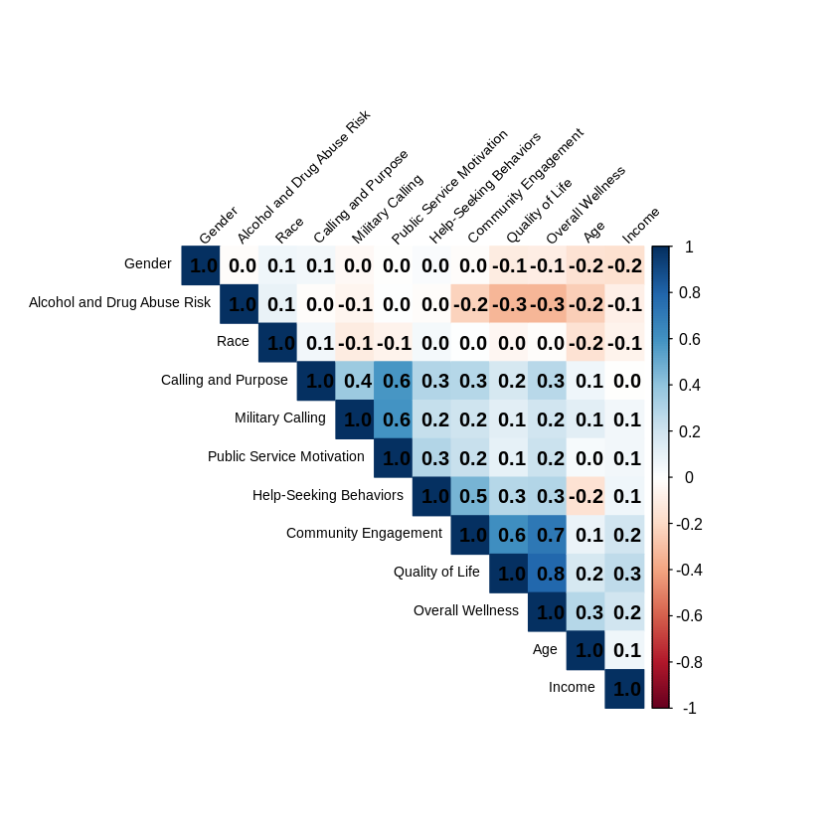
MULTIPLE LINEAR REGRESSION
Correlation Plot Between All Protective Factors* and Alcohol and Drug Abuse Risk
(adjusted for confounders**)
Figure 1
* Protective Factors = Calling and Purpose, Community Engagement, Help-Seeking Behaviors, Military Calling, Quality of Life Score, Public Service Motivation and Overall Wellness
**Confounding Factors = Age, Gender, Race, and Income (Brown, 1995)

Slide 40
MULITPLE LINEAR REGRESSION SUMMARY TABLES
Table 6 Protective Factors Independently Associated with Alcohol and Drug Abuse Risk using Multiple Linear Regression among Veterans in The 2022 Military Health and Well-Being Project from ICPSR Michigan (N=1,495) (adjusted for confounders)
Measures | ß | SE | t value | p-value
Constant | 3.609 | 0.324 | 11.124 |  |  | R = | 0.414
Calling and Purpose | 0.0186 | 0.013 | 1.437 | 0.151 |  | R² = | 0.171
Community Engagement | -0.0035 | 0.010 | -0.365 | 0.715 |  | Overall p value = | <0.001
Help-Seeking Behavior | 0.0173 | 0.009 | 1.944 | 0.052
Military Calling | -0.0084 | 0.110 | -0.770 | 0.442
Quality of Life | -0.0158 | 0.003 | -5.348 | <0.001 | *
Public Service Motivation | 0.0164 | 0.014 | 1.206 | 0.228
Overall Wellness | -0.0098 | 0.003 | -3.207 | <0.001 | *
Confounders
Age | 0.0152 | 0.003 | -5.747 | <0.001 | *
Gender (Male vs. Female vs. Other) | -0.222 | 0.068 | -3.277 | 0.001 | *
Race (White vs. Non-white) | 0.196 | 0.085 | 2.314 | 0.021 | *
Income | <0.001 | <0.001 | -0.132 | 0.8950
*Denotes p-value < 0.05
Notes:
*

Slide 41
MULITPLE LINEAR REGRESSION
Regression Analysis Protective Factors
(adjusted for confounders)
Interpretation Statements
There is no correlation between Alcohol and Drug Abuse Risk and the Protective Factors (R = 0.381).
17.1 % of the variance in Alcohol and Drug Abuse Risk is explained by the Protective Factors.
The Protective Factors are independently associated with Alcohol and Drug Abuse Risk (p < 0.001).
Among the Protective Factors, Calling and Purpose contributed the greatest to the variance (0.0186) to Alcohol and Drug Abuse Risk; however, it was not statistically significant.
Quality of Life (-0.0158) and Overall Wellness (-0.0098) contributed less; however, they were statistically significant.

Slide 42
MULITPLE LINEAR REGRESSION
Regression Analysis Protective Factors
(adjusted for confounders)
Interpretation Statements
After adjusting for Calling and Purpose, Community Engagement, Help-Seeking Behaviors, Military Calling, Public Service Motivation, and Overall Wellness, Quality of Life is significantly associated with Alcohol and Drug Risk Abuse (p < 0.001).
After adjusting for Calling and Purpose, Community Engagement, Help-Seeking Behaviors, Military Calling, Public Service Motivation, and Quality of Life, Overall Wellness is significantly associated with Alcohol and Drug Risk Abuse (p < 0.001).

Slide 43
RISK FACTORS
(X_{N1} through X_{N7})
Combat Exposure
Daily Stress
Loneliness
Moral Injury
Self-Stigmatization
Suicide Risk
History of Traumatic Brain Injury

Slide 44
MULTIPLE LINEAR REGRESSION
Pearson’s Correlation Table Between Risk Factors* and Alcohol and Drug Abuse Risk
(adjusted for confounders**)
Table 7 | Alcohol and Drug Abuse Risk | Combat Exposure | Daily Stress | Loneliness | Moral Injury | Self-Stigma | Suicide Risk | History of Traumatic Brain Injury | Age | Gender | Race | Income
Alcohol and Drug Abuse Risk | 1
Combat Exposure | 0.24 | 1
Daily Stress | 0.36 | 0.31 | 1
Loneliness | 0.33 | 0.2 | 0.33 | 1
Moral Injury | 0.42 | 0.33 | 0.44 | 0.54 | 1
Self-Stigma | 0.22 | 0.25 | 0.3 | 0.23 | 0.46 | 1
Suicide Risk | 0.4 | 0.22 | 0.33 | 0.41 | 0.51 | 0.21 | 1
History of Traumatic Brain Injury | 0.14 | 0.18 | 0.18 | 0.16 | 0.19 | 0.1 | 0.2 | 1
Age | -0.25 | -0.43 | -0.43 | -0.26 | -0.41 | -0.4 | -0.25 | -0.1 | 1
Gender | -0.01 | -0.07 | 0.1 | 0.11 | 0.08 | 0 | 0.18 | 0.01 | -0.15 | 1
Race | 0.09 | 0.1 | 0.09 | 0.04 | 0.09 | 0.1 | 0.07 | -0.01 | -0.15 | 0.08 | 1
Income | -0.09 | 0.1 | -0.01 | -0.18 | -0.13 | -0.05 | -0.12 | -0.05 | 0.05 | -0.16 | -0.07 | 1
* Risk Factors = Combat Exposure, Daily Stress, Loneliness, Moral Injury, Self-Stigmatization, Suicide Risk, and History of Traumatic Brain Injury
**Confounding Factors = Age, Gender, Race, and Income (Brown, 1995)
Green filled boxes indicate correlation >0.50
Interpretation Statements
Direct Correlations
Moral Injury and Loneliness (0.54)
Moral Injury and Suicide Risk (0.51)

Slide 45
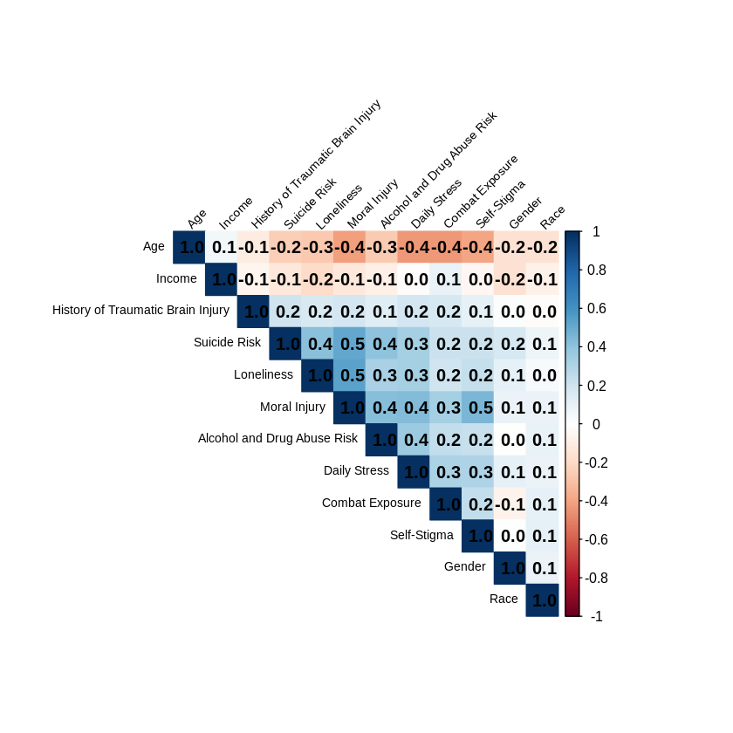
MULTIPLE LINEAR REGRESSION
Correlation Plot Between All Risk Factors* and Alcohol and Drug Abuse Risk
(adjusted for confounders)
Figure 3
* Risk Factors = Combat Exposure, Daily Stress, Loneliness, Moral Injury, Self-Stigmatization, Suicide Risk, and History of Traumatic Brain Injury
Confounding Factors = Age, Gender, Race, and Income (Brown, 1995)

Slide 46
MULITPLE LINEAR REGRESSION SUMMARY TABLES
Table 9 Risk Factors Independently Associated with Alcohol and Drug Abuse Risk using Multiple Linear Regression among Veterans in The 2022 Military Health and Well-Being Project from ICPSR Michigan (N=1,495) (adjusted for confounders)
Measures | ß | SE | t value | p-value
Constant | -0.040 | 0.272 | -1.483 | 0.138 |  | R = | 0.5122
Combat Exposure | 0.1154 | 0.058 | 1.989 | 0.047 | * | R² = | 0.2624
Daily Stress | 0.1286 | 0.020 | 6.408 | <0.001 | * | Overall p value = | <0.001
Loneliness | 0.0523 | 0.019 | 2.730 | 0.006 | *
Moral Injury | 0.0131 | 0.003 | 4.693 | <0.001 | *
Self-Stigmatization | 0.0110 | 0.007 | 0.159 | 0.874
Suicide Risk | 0.0808 | 0.010 | 8.234 | <0.001 | *
History of Traumatic Brain Injury | 0.1110 | 0.083 | 0.135 | 0.8930
Confounders
Age | -0.0107 | 0.003 | -0.383 | 0.7019
Gender (Male vs. Female vs. Other) | -0.2656 | 0.064 | -4.123 | <0.001 | *
Race (White vs. Non-white) | 0.1512 | 0.077 | 1.952 | 0.0512
Income | <0.001 | <0.001 | -1.655 | 0.0981
*Denotes p-value < 0.05
Notes:
*

Slide 47
MULITPLE LINEAR REGRESSION
Regression Analysis Model Risk Factors
(adjusted for confounders)
Interpretation Statements
There is a correlation between Alcohol and Drug Abuse Risk and the Risk Factors (R = 0.5122).
26.2 % of the variance in Alcohol and Drug Abuse Risk is explained by the Risk Factors.
The Risk Factors are independently associated with Alcohol and Drug Abuse Risk (p < 0.001).
Among the Risk Factors, Daily Stress contributes the greatest to the variance (0.129) to Alcohol and Drug Abuse Risk.

Slide 48
MULITPLE LINEAR REGRESSION
Regression Analysis Model Risk Factors
(adjusted for confounders)
Interpretation Statements
After adjusting for Daily Stress, Loneliness, Moral Injury, Self-Stigmatization, Suicide Risk, and History of Traumatic Brain Injury, Combat Exposure is significantly associated with Alcohol and Drug Risk Abuse (p = 0.047).
After adjusting for Combat Exposure, Loneliness, Moral Injury, Self-Stigmatization, Suicide Risk, and History of Traumatic Brain Injury, Daily Stress is significantly associated with Alcohol and Drug Risk Abuse (p < 0.001).
After adjusting for Combat Exposure, Daily Stress, Moral Injury, Self-Stigmatization, Suicide Risk, and History of Traumatic Brain Injury, Loneliness is significantly associated with Alcohol and Drug Risk Abuse (p < 0.0006).
After adjusting for Combat Exposure, Daily Stress, Loneliness, Self-Stigmatization, Suicide Risk, and History of Traumatic Brain Injury, Moral Injury is significantly associated with Alcohol and Drug Risk Abuse (p < 0.001).
After adjusting for Combat Exposure, Daily Stress, Loneliness, Moral Injury, Self-Stigmatization, and History of Traumatic Brain Injury, Suicide Risk is significantly associated with Alcohol and Drug Risk Abuse (p < 0.001)

Slide 49
BUFFERING EFFECTS OF PROTECTIVE VS.RISK FACTORS
(X_{P1} through X_{P7} and X_{N1} through X_{N7})
Combat Exposure
Daily Stress
Loneliness
Moral Injury
Self-Stigmatization
Suicide Risk
History of Traumatic Brain Injury
Calling and Purpose
Community Engagement
Help-Seeking Behaviors
Military Calling
Quality of Life
Public Service Motivation
Overall Wellness

Slide 50
MULTIPLE LINEAR REGRESSION
Pearson’s Correlation Table Between Protective* and Risk Factors** and Alcohol and Drug Abuse Risk (adjusted for confounders***)
Table 10 | Alcohol and Drug Abuse Risk | Purpose in Life | Social Support | Help-Seeking Behaviors | Military Calling | Quality of Life | Public Service Motivation | Overall Wellness | Combat Exposure | Daily Stress | Loneliness | Moral Injury | Self-Stigma | Suicide Risk | History of Traumatic Brain Injury | Age | Gender | Race | Income
Alcohol and Drug Abuse Risk | 1
Purpose in Life | -0.01 | 1
Social Support | -0.22 | 0.28 | 1
Help-Seeking Behaviors | 0 | 0.29 | 0.46 | 1
Military Calling | -0.06 | 0.36 | 0.2 | 0.22 | 1
Quality of Life | -0.33 | 0.17 | 0.61 | 0.28 | 0.13 | 1
Public Service Motivation | 0.01 | 0.59 | 0.23 | 0.29 | 0.58 | 0.11 | 1
Overall Wellness | -0.34 | 0.27 | 0.71 | 0.29 | 0.2 | 0.78 | 0.22 | 1
Combat Exposure | 0.24 | 0.01 | -0.01 | 0.14 | 0.02 | -0.13 | 0.11 | -0.14 | 1
Daily Stress | 0.36 | -0.04 | -0.15 | 0.03 | -0.1 | -0.33 | 0.01 | -0.32 | 0.31 | 1
Loneliness | 0.33 | 0 | -0.47 | -0.19 | -0.05 | -0.59 | 0.02 | -0.58 | 0.2 | 0.33 | 1
Moral Injury | 0.42 | -0.18 | -0.51 | -0.14 | -0.2 | -0.62 | -0.13 | -0.7 | 0.33 | 0.44 | 0.54 | 1
Self-Stigma | 0.22 | -0.21 | -0.2 | 0.01 | -0.41 | -0.22 | -0.27 | -0.31 | 0.25 | 0.3 | 0.23 | 0.46 | 1
Suicide Risk | 0.4 | -0.07 | -0.39 | -0.12 | -0.09 | -0.53 | -0.02 | -0.53 | 0.22 | 0.33 | 0.41 | 0.51 | 0.21 | 1
History of Traumatic Brain Injury | 0.14 | 0 | -0.13 | -0.04 | 0.01 | -0.22 | 0.02 | -0.16 | 0.18 | 0.18 | 0.16 | 0.19 | 0.1 | 0.2 | 1
Age | -0.25 | 0.06 | 0.08 | -0.16 | 0.13 | 0.18 | 0.03 | 0.28 | -0.43 | -0.43 | -0.26 | -0.41 | -0.4 | -0.25 | -0.1 | 1
Gender | -0.01 | 0.05 | -0.03 | 0.03 | -0.05 | -0.11 | -0.01 | -0.1 | -0.07 | 0.1 | 0.11 | 0.08 | 0 | 0.18 | 0.01 | -0.15 | 1
Race | 0.09 | 0.05 | 0 | 0.04 | -0.11 | -0.04 | -0.06 | -0.02 | 0.1 | 0.09 | 0.04 | 0.09 | 0.1 | 0.07 | -0.01 | -0.15 | 0.08 | 1
Income | -0.09 | 0 | 0.2 | 0.07 | 0.05 | 0.26 | 0.06 | 0.2 | 0.1 | -0.01 | -0.18 | -0.13 | -0.05 | -0.12 | -0.05 | 0.05 | -0.16 | -0.07 | 1
*Protective Factors = Calling and Purpose, Community Engagement, Help-Seeking Behaviors, Military Calling, Quality of Life Score, Public Service Motivation and Overall Wellness
**Risk Factors = Combat Exposure, Daily Stress, Loneliness, Moral Injury, Self-Stigmatization, Suicide Risk, and History of Traumatic Brain Injury
***Confounding Factors = Age, Gender, Race, and Income (Brown, 1995)
Green filled boxes indicate correlation >0.50
Red filled boxes indicate correlation < -0.05
Interpretation Statements
Direct Correlations Indirect Correlations
Purpose in Life and Public Service Motivation (0.59) Moral Injury and Social Support (-0.51)
Social Support and Quality of Life (0.61) Quality of Life and Loneliness (-0.59)
Social Support and Overall Wellness (0.71) Quality of Life and Moral Injury (-0.62)
Military Calling and Public Service Motivation (0.58) Quality of Life and Suicide Risk (-0.53)
Quality of Life and Overall Wellness (0.78) Overall Wellness and Loneliness (-0.58)
Overall Wellness and Moral Injury (-0.70)
Overall Wellness and Suicide Risk (-0.53)

Slide 51
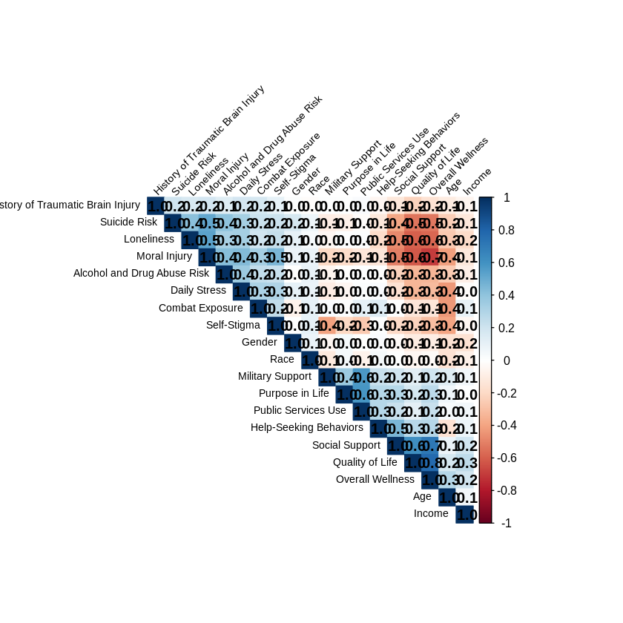
MULTIPLE LINEAR REGRESSION
Correlation Plot Between Protective* and Risk Factors** and Alcohol and Drug Abuse Risk
(adjusted for confounders***)
Figure 4
*Protective Factors = Calling and Purpose, Community Engagement, Help-Seeking Behaviors, Military Calling, Quality of Life Score, Public Service Motivation and Overall Wellness
**Risk Factors = Combat Exposure, Daily Stress, Loneliness, Moral Injury, Self-Stigmatization, Suicide Risk, and History of Traumatic Brain Injury
***Confounding Factors = Age, Gender, Race, and Income

Slide 52
MULITPLE LINEAR REGRESSION SUMMARY TABLES
Table 11 Protective and Risk Factors Independently Associated with Alcohol and Drug Abuse Risk using Multiple Linear Regression among Veterans in The 2022 Military Health and Well-Being Project from ICPSR Michigan (N=1,495) (adjusted for confounders)
Measures | ß | SE | t value | p-value
Constant | -0.726 | 0.515 | -1.410 |  |  | R = | 0.5181
Calling and Purpose | 0.160 | 0.012 | 1.292 | 0.1964 |  | R² = | 0.2684
Community Engagement | 0.002 | 0.009 | 0.184 | 0.8542 |  | Overall p value = | <0.001
Help-Seeking Behavior | 0.015 | 0.008 | 1.744 | 0.0813
Military Calling | 0.003 | 0.110 | 0.244 | 0.8076
Quality of Life | -0.002 | 0.003 | -0.716 | 0.4742
Public Service Motivation | -0.002 | 0.013 | -0.142 | 0.8873
Overall Wellness | -0.000 | 0.003 | -0.184 | 0.8542
Combat Exposure | 0.011 | 0.006 | 1.771 | 0.0768
Daily Stress | 0.124 | 0.021 | 6.034 | <0.001 | *
Loneliness | 0.048 | 0.022 | 2.233 | 0.0257 | *
Moral Injury | 0.013 | 0.003 | 4.079 | <0.001 | *
Self-Stigmatization | 0.004 | 0.008 | 0.567 | 0.5709
Suicide Risk | 0.081 | 0.010 | 7.765 | <0.001 | *
History of Traumatic Brain Injury | 0.014 | 0.084 | 0.167 | 0.8677
Confounders
Age | -0.000 | 0.003 | -0.071 | 0.9431
Gender (Male vs. Female vs. Other) | -0.027 | 0.066 | -4.115 | < 0.001 | *
Race (White vs. Non-white) | 0.139 | 0.080 | 1.741 | 0.0820
Income | 0.000 | 0.000 | -1.336 | 0.1818
*Denotes p-value < 0.05
Notes:
*

Slide 53
MULITPLE LINEAR REGRESSION
Regression Analysis for Protective and Risk Factors
(adjusted for confounders)
Interpretation Statements
There is a correlation between Alcohol and Drug Abuse Risk and the Risk Factors (R = 0.5181).
26.8 % of the variance in Alcohol and Drug Abuse Risk is explained by the Protective and Risk Factors.
The Protective and Risk Factors are independently associated with Alcohol and Drug Abuse Risk (p < 0.001).
Among all the factors, Daily Stress contributes the greatest to the variance (0.124) of alcohol and drug abuse.

Slide 54
MULITPLE LINEAR REGRESSION
Regression Analysis Protective and Risk Factors
(adjusted for confounders)
Interpretation Statements
After adjusting for Calling and Purpose, Community Engagement, Help-Seeking Behaviors, Military Calling, Quality of Life, Public Service Motivation, Overall Wellness, Loneliness, Moral Injury, Self-Stigmatization, Suicide Risk, and History of Traumatic Brain Injury, Daily Stress is significantly associated with Alcohol and Drug Risk Abuse(p < 0.001).
After adjusting for Calling and Purpose, Community Engagement, Help-Seeking Behaviors, Military Calling, Quality of Life, Public Service Motivation, and Overall Wellness, Daily Stress, Moral Injury, Self-Stigmatization, Suicide Risk, and History of Traumatic Brain Injury, Loneliness is significantly associated with Alcohol and Drug Risk Abuse(p = 0.0257).
After adjusting for Calling and Purpose, Community Engagement, Help-Seeking Behaviors, Military Calling, Quality of Life, Public Service Motivation, Overall Wellness, Daily Stress, Loneliness, Self-Stigmatization, Suicide Risk, and History of Traumatic Brain Injury, Moral Injury is significantly associated with Alcohol and Drug Risk Abuse(p < 0.001).
After adjusting for Calling and Purpose, Community Engagement, Help-Seeking Behaviors, Military Calling, Quality of Life, Public Service Motivation, Overall Wellness, Daily Stress, Loneliness, Moral Injury, Self-Stigmatization, and History of Traumatic Brain Injury, Suicide Risk is significantly associated with Alcohol and Drug Abuse Risk (p < 0.001).

Slide 55
MULTIPLE LINEAR REGRESSION
Combined Saturated Model
Research Aims
(adjusted for confounders)
What is the buffering effect of protective factors on the risk factors related to alcohol abuse risk in US Veterans?
Minimal buffering effect.
What is the association of protective and risk factors with alcohol abuse risk use among US Veterans?
There is a correlation between Alcohol and Drug Abuse Risk and the protective
and risk factors (R = 0.5181).
When evaluating all the factors simultaneously, which construct accounts for the greatest variability in alcohol abuse risk?
Daily Stress (0.1240)

Slide 56
Reduced Model

Slide 57
MULTIPLE LINEAR REGRESSION
Pearson’s Correlation Table Between Reduced Model Factors* and Alcohol and Drug Abuse Risk (adjusted for confounders**)
Table 11 | Alcohol and Drug Abuse Risk | Daily Stress | Loneliness | Moral Injury | Suicide Risk | Age | Gender | Race | Income
Alcohol and Drug Abuse Risk | 1
Daily Stress | 0.360395 | 1
Loneliness | 0.325762 | 0.330626 | 1
Moral Injury | 0.420049 | 0.439269 | 0.53509148 | 1
Suicide Risk | 0.40397 | 0.330806 | 0.41089095 | 0.514361 | 1
Age | -0.253868 | -0.434212 | -0.2635684 | -0.413756 | -0.248279 | 1
Gender | -0.005183 | 0.100829 | 0.10737591 | 0.082135 | 0.179158 | -0.15411 | 1
Race | 0.090843 | 0.0865 | 0.03549848 | 0.087059 | 0.074025 | -0.152828 | 0.080053 | 1
Income | -0.08578 | -0.01382 | -0.1826259 | -0.12795 | -0.120156 | 0.05349 | -0.157907 | -0.073155 | 1
*Reduced Model Factors = Daily Stress, Loneliness, Moral Injury, and Suicide Risk
**Confounding Factors = Age, Gender, Race, and Income (Brown, 1995)
Green filled boxes indicate correlation >0.50
Interpretation Statements
Direct Correlations
Moral Injury and Loneliness (0.54)
Moral Injury and Suicide Risk (0.51)

Slide 58
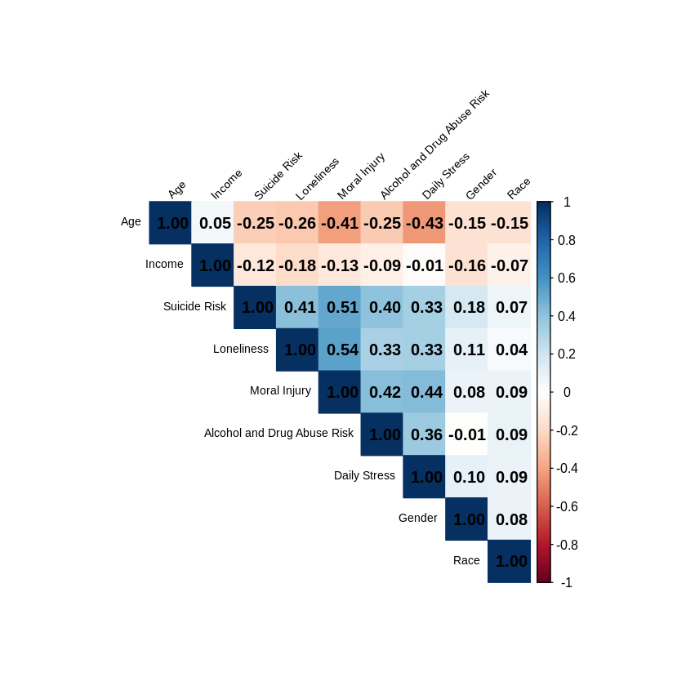
MULTIPLE LINEAR REGRESSION
Correlation Plot Between Reduced Factors* and Alcohol and Drug Abuse Risk
(adjusted for confounders**)
Figure 6
*Reduced Model Factors = Daily Stress, Loneliness, Moral Injury, Suicide Risk
**Confounding Factors = Age, Gender, Race, and Income (Brown, 1995)

Slide 59
MULITPLE LINEAR REGRESSION SUMMARY TABLES
Table 12 Reduced Model Factors* Independently Associated with Alcohol and Drug Abuse Risk using Multiple Linear Regression among Veterans in The 2022 Military Health and Well-Being Project from ICPSR Michigan (N=1,495) (adjusted for confounders**)
Measures | ß | SE | t value | p-value
Constant | -0.2042 | 0.2461 | -0.830 |  |  | R = | 0.5111
Daily Stress | 0.1341 | 0.1991 | 6.650 | < 0.001 | * | R² = | 0.2603
Loneliness | 0.0527 | 0.1914 | 2.752 | 0.006 | * | Overall p value = | <0.001
Moral Injury | 0.0138 | 0.0266 | 5.202 | < 0.001 | *
Suicide Risk | 0.0821 | 0.0097 | 8.431 | < 0.001 | *
Confounders
Age | -0.0029 | 0.0026 | -1.141 | 0.2541
Gender (Male vs. Female vs. Other) | -0.0286 | 0.6347 | -4.512 | < 0.001 | *
Race (White vs. Non-white) | 0.1606 | 0.0772 | 2.081 | 0.0376 | *
Income | <0.001 | <0.001 | -1.393 | 0.1637
*Denotes p-value < 0.05
*Reduced Model Factors = Daily Stress, Loneliness, Moral Injury, Suicide Risk
**Confounding Factors = Age, Gender, Race, and Income (Brown, 1995)
Notes:
*

Slide 60
MULITPLE LINEAR REGRESSION
Regression Analysis for Reduced Model*
(adjusted for confounders**)
Interpretation Statements
There is a correlation between Alcohol and Drug Abuse Risk and the reduced model factors (R = 0.5111).
26.0 % of the variance in Alcohol and Drug Abuse Risk is explained by the reduced model factors.
The reduced model factors are independently associated with Alcohol and Drug Abuse Risk
(p < 0.001).
Among all the reduced model factors, Daily Stress contributes the greatest to the variance (0.1341) to alcohol and drug abuse.
*Reduced Model Factors = Daily Stress, Loneliness, Moral Injury, Suicide Risk
**Confounding Factors = Age, Gender, Race, and Income (Brown, 1995)

Slide 61
MULITPLE LINEAR REGRESSION
Regression Analysis Reduced Factors
(adjusted for confounders)
Interpretation Statements
After adjusting for Loneliness, Moral Injury, and Suicide Risk, Daily Stress is significantly associated with Alcohol and Drug Risk Abuse (p < 0.001).
After adjusting for Daily Stress, Moral Injury, and Suicide Risk, Loneliness is significantly associated with Alcohol and Drug Risk Abuse (p = 0.006).
After adjusting for Daily Stress, Loneliness, and Suicide Risk, Moral Injury is significantly associated with Alcohol and Drug Risk Abuse (p < 0.001).
After adjusting for Daily Stress, Loneliness, and Moral Injury, Suicide Risk is significantly associated with Alcohol and Drug Risk Abuse (p < 0.001).

Slide 62
MULITPLE LINEAR REGRESSION SUMMARY TABLES
Table 13 Reduced Factors Independently Associated with Alcohol and Drug Abuse Risk using Cohen Convention among Veterans in The 2022 Military Health and Well-Being Project from ICPSR Michigan (N=1,495) (adjusted for confounders)
Measures | Effect Size | Cohen Convention
Constant | 0.204 | Medium
Daily Stress | 0.132 | Medium
Loneliness | 0.053 | Small
Moral Injury | 0.014 | Small
Suicide Risk | 0.082 | Small
Confounders
Age | 0.003 | Small
Gender (Male vs. Female vs. Other) | 0.286 | Medium
Race (White vs. Non-white) | 0.161 | Medium
Income | <0.001 | Small
Notes:
*

Slide 63
MULITPLE LINEAR REGRESSION Summary Tables
TABLE 2: Model 3 Risk Factors* Independently Associated with Alcohol and Drug Abuse Risk using Multiple Linear Regression among Veterans in The 2022 Military Health and Well-Being Project from ICPSR Michigan (N=1,495)
Measures | ß | p-value
Constant | -0.787 |  |  | R = | 0.4913
 |  |  |  | R² = | 0.2414
 |  |  |  | Overall p-value | <0.001
Combat Exposure (scale) | 0.015 | <0.001 | #
Daily Stress (Scale) | 0.121 | 0.004 | #
Loneliness (Scale) | 0.054 | <0.001 | #
Moral Injury (Scale) | 0.014 | <0.001
Self-Stigmatization (Scale) | 0.004 | 0.492
Suicide Risk (Scale) | 0.076 | <0.001 | #
History of Traumatic Brain Injury (Binary) | 0.014 | 0.866
# Denotes p-value < 0.05
*Combat Exposure, Daily Stress, Loneliness, Moral Injury, Self-Stigmatization, Suicide Risk, and History of Traumatic Brain Injury
Notes:
*

Slide 64
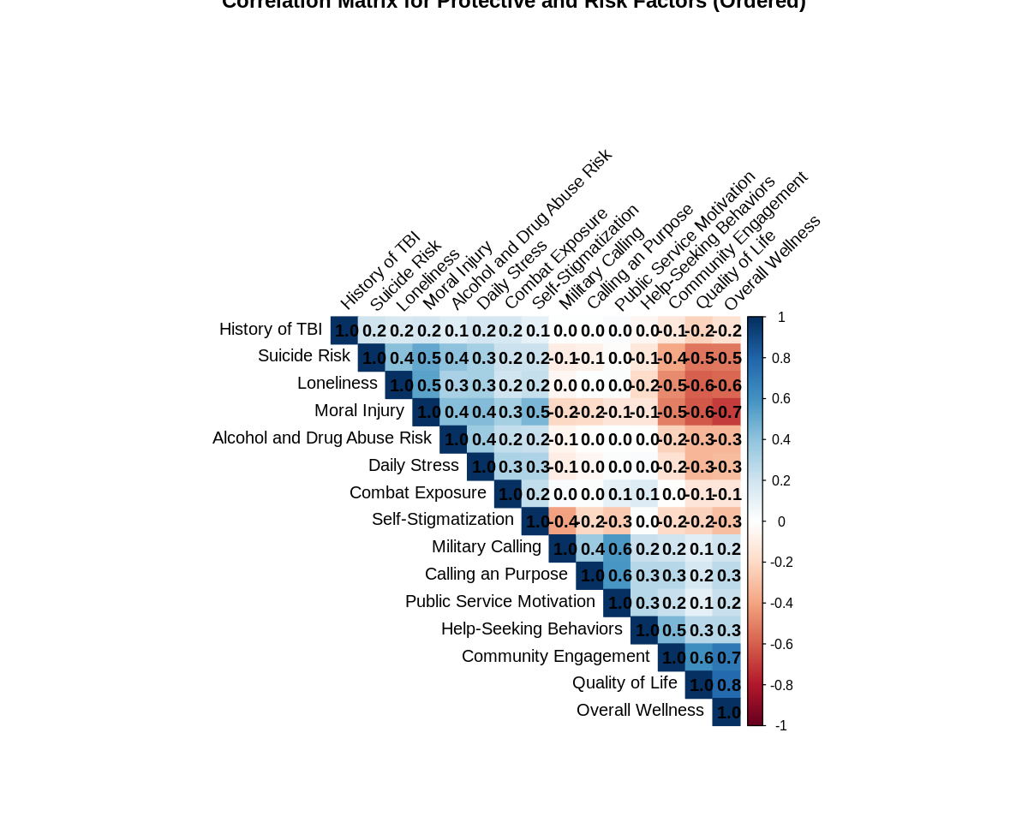
MULTIPLE LINEAR REGRESSION
Correlation Plot Between All Protective* and Risk Factors* and Alcohol and Drug Abuse Risk

Slide 65
MULTIPLE LINEAR REGRESSION
Pearson’s Correlation Plot Between All Protective* and Risk Factors** and Alcohol and Drug Abuse Risk Without Confounders
 | Alcohol and Drug Abuse Risk | Calling and Purpose | Community Engagement | Help-Seeking Behavior | Public Service Motivation | Military Calling | Quality of Life | Overall Wellness | Community Engagement | Daily Stress | Loneliness | Moral Injury | Self-Stigmatization | Suicide Risk | History of TBI
Alcohol and Drug Abuse Risk | 1.000
Calling and Purpose | -0.007 | 1.000
Community Engagement | -0.222 | 0.280 | 1.000
Help-Seeking Behavior | -0.004 | 0.290 | 0.457 | 1.000
Public Service Motivation | 0.007 | 0.587 | 0.225 | 0.289 | 1.000
Military Calling | -0.056 | 0.361 | 0.196 | 0.221 | 0.579 | 1.000
Quality of Life | -0.333 | 0.175 | 0.611 | 0.279 | 0.112 | 0.125 | 1.000
Overall Wellness | -0.338 | 0.267 | 0.711 | 0.289 | 0.220 | 0.199 | 0.778 | 1.000
Community Engagement | 0.244 | 0.014 | -0.008 | 0.144 | 0.106 | 0.023 | -0.135 | -0.139 | 1.000
Daily Stress | 0.360 | -0.043 | -0.153 | 0.028 | 0.010 | -0.097 | -0.332 | -0.317 | 0.312 | 1.000
Loneliness | 0.326 | 0.004 | -0.474 | -0.188 | 0.018 | -0.048 | -0.594 | -0.579 | 0.198 | 0.331 | 1.000
Moral Injury | 0.420 | -0.183 | -0.509 | -0.137 | -0.131 | -0.205 | -0.619 | -0.697 | 0.332 | 0.439 | 0.535 | 1.000
Self-Stigmatization | 0.223 | -0.207 | -0.198 | 0.014 | -0.265 | -0.409 | -0.222 | -0.307 | 0.248 | 0.304 | 0.232 | 0.456 | 1.000
Suicide Risk | 0.404 | -0.074 | -0.390 | -0.123 | -0.020 | -0.091 | -0.532 | -0.529 | 0.219 | 0.331 | 0.411 | 0.514 | 0.211 | 1.000
History of TBI | 0.136 | 0.001 | -0.127 | -0.042 | 0.021 | 0.005 | -0.221 | -0.157 | 0.179 | 0.184 | 0.164 | 0.188 | 0.103 | 0.204 | 1.000
*Calling and Purpose, Community Engagement, Help-Seeking Behaviors, Military Calling, Quality of Life Score, Public Service Motivation and Overall Wellness
**Combat Exposure, Daily Stress, Loneliness, Moral Injury, Self-Stigmatization, Suicide Risk, and History of Traumatic Brain Injury
Green filled box indication correlation >0.50
Interpretation Statements
Positive Correlations Negative Correlations
Calling and Purpose with Public Service Motivation Loneliness and Quality of Life
Community Engagement with Quality of Life Overall Wellness with Moral Injury
Community Engagement and Overall Wellness Overall Wellness with Suicide Risk
Military Calling and Public Service Motivation Overall Wellness with Loneliness
Quality of Life and Overall Wellness Moral Injury and Quality of Life
Moral Injury with Loneliness
Moral Injury with Suicide Risk

Slide 66
MULITPLE LINEAR REGRESSION SUMMARY TABLES
TABLE 2: Protective Factors* without Confounders Independently Associated with Alcohol and Drug Abuse Risk using Multiple Linear Regression among Veterans in The 2022 Military Health and Well-Being Project from ICPSR Michigan (N=1,495)
Measures | ß | p-value
Constant | 2.999 |  |  | R= | 0.381
 |  |  |  | R²= | 0.1452
 |  |  |  | Overall p-value | <0.001
Calling and Purpose (scale) | 0.0198 | 0.121
Community Engagement (Scale) | 0.0011 | 0.906
Help-Seeking Behavior (Scale) | 0.0311 | <0.001 | #
Military Calling (Scale) | -0.0202 | 0.0598
Quality of Life (Scale) | -0.1327 | <0.001 | #
Public Service Motivation (Scale) | 0.0206 | 0.124
Overall Wellness (Scale) | -0.0159 | <0.001 | #
# Denotes p-value < 0.05
*Calling and Purpose, Community Engagement, Help-Seeking Behaviors, Military Calling, Quality of Life Score, Public Service Motivation and Wellness
Notes:
*

Slide 67
MULITPLE LINEAR REGRESSION Summary Tables
TABLE 2: Model 3 Risk Factors* Independently Associated with Alcohol and Drug Abuse Risk using Multiple Linear Regression among Veterans in The 2022 Military Health and Well-Being Project from ICPSR Michigan (N=1,495)
Measures | ß | p-value
Constant | -0.787 |  |  | R= | 0.4913
 |  |  |  | R² = | 0.2414
 |  |  |  | Overall p-value | <0.001
Combat Exposure (scale) | 0.015 | <0.001 | #
Daily Stress (Scale) | 0.121 | 0.004 | #
Loneliness (Scale) | 0.054 | <0.001 | #
Moral Injury (Scale) | 0.014 | <0.001
Self-Stigmatization (Scale) | 0.004 | 0.492
Suicide Risk (Scale) | 0.076 | <0.001 | #
History of Traumatic Brain Injury (Binary) | 0.014 | 0.866
# Denotes p-value < 0.05
*Combat Exposure, Daily Stress, Loneliness, Moral Injury, Self-Stigmatization, Suicide Risk, and History of Traumatic Brain Injury
Notes:
*

Slide 68
PROTECTIVE FACTORS
(X_{P1} through X_{P7})
Calling and Purpose
Community Engagement
Help-Seeking Behaviors
Military Calling
Quality of Life
Public Service Motivation
Overall Wellness

Slide 69
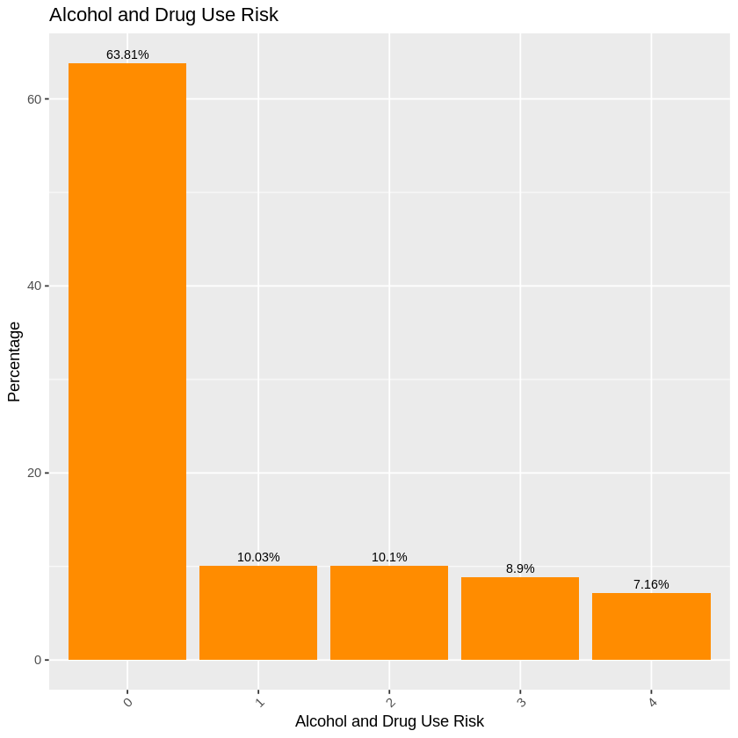
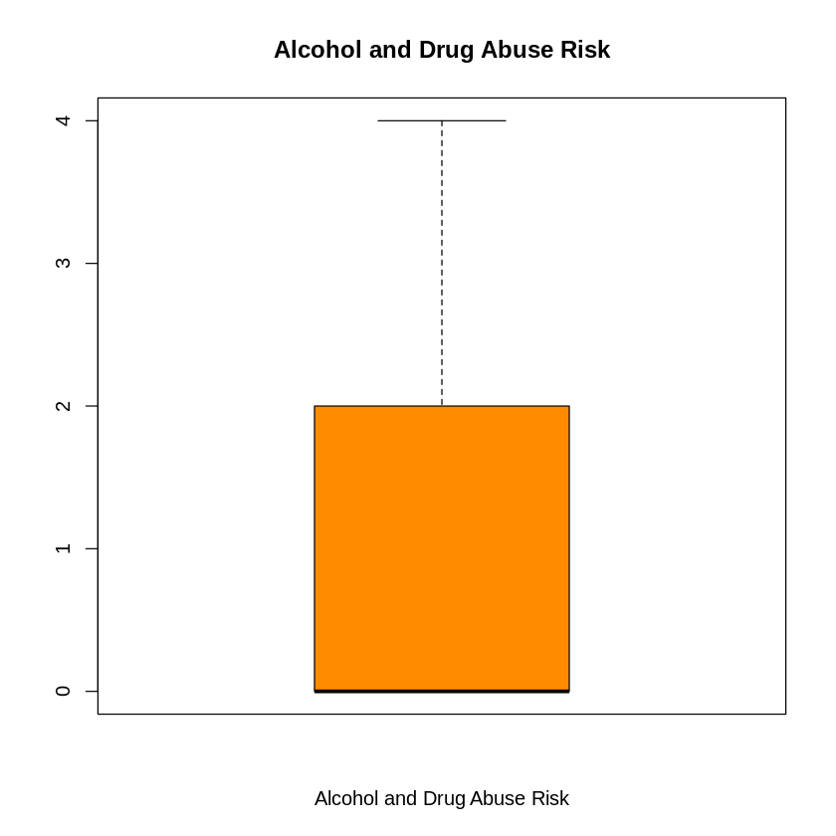
MULTIPLE LINEAR REGRESSION
Univariate Statistics for Alcohol and Drug Abuse Risk (Y)
Descriptive Statistics Table
Histogram and Box Plot
Statistics
Alcohol and Drug Abuse Risk
N | Valid | 1,495
 | Missing | 0
Mean |  | 0.855
Median |  | 0.00
Std. Deviation |  | 1.3113
Minimum |  | 0.00
Maximum |  | 4.00
Percentiles | 25 | 0.00
 | 50 | 0.00
 | 75 | 2.00
Interpretation Statement
Among the 1,495 veterans, the 5-point summary for Alcohol and Drug Abuse Risk is (0, 0, 1, 2, 4)

Slide 70
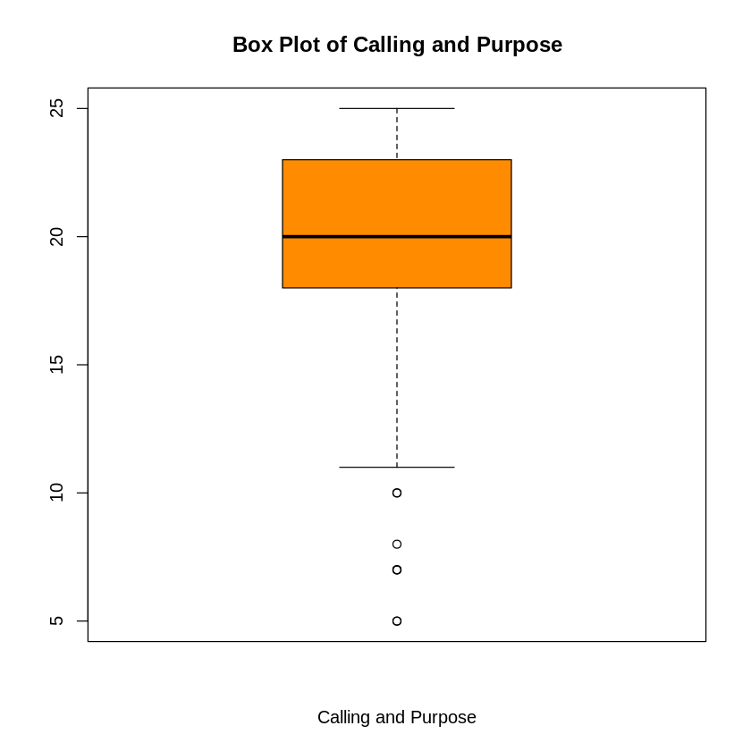
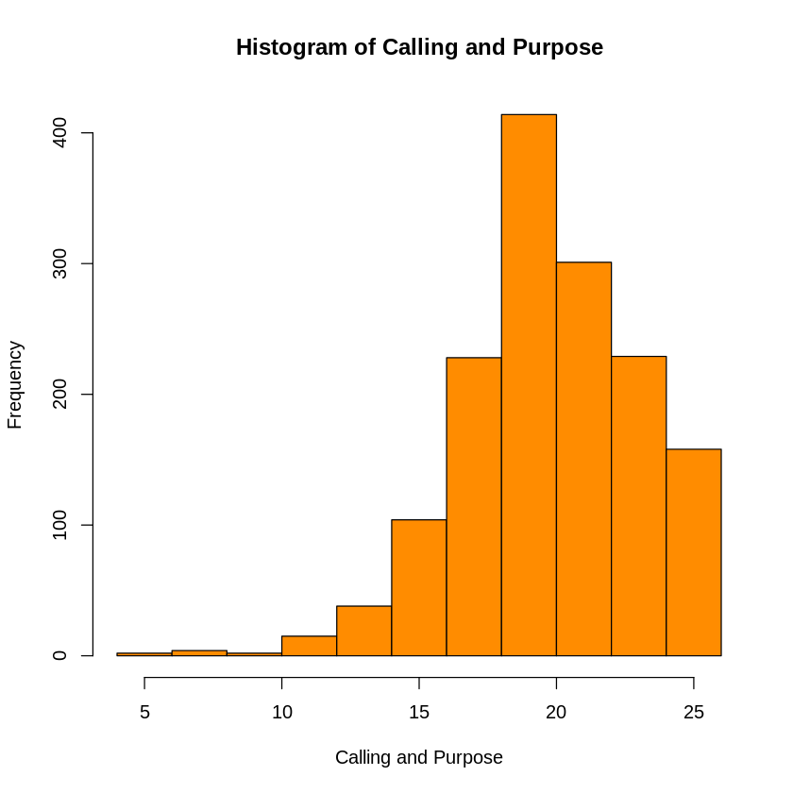
MULTIPLE LINEAR REGRESSION
Univariate Statistics for Calling and Purpose (X_{P1})
Descriptive Statistics Table
Histogram and Box Plot
Statistics
Calling and Purpose
N | Valid | 1,495
 | Missing | 0
Mean |  | 20.24
Median |  | 20.00
Std. Deviation |  | 3.1526
Minimum |  | 5.00
Maximum |  | 25.00
Percentiles | 25 | 18.00
 | 50 | 20.00
 | 75 | 23.00
Interpretation Statement
Among the 1,495 veterans, the 5-point summary for Calling and Purpose is (5, 18, 20, 23, 25)

Slide 71
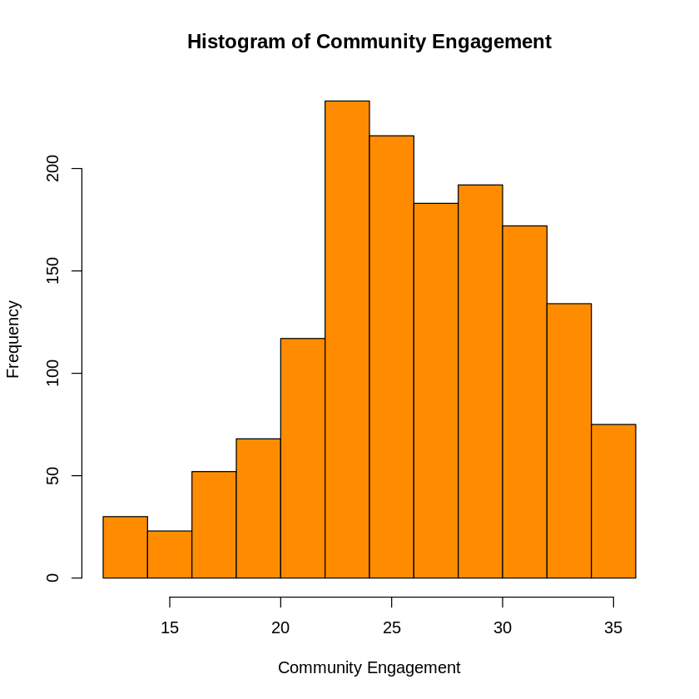
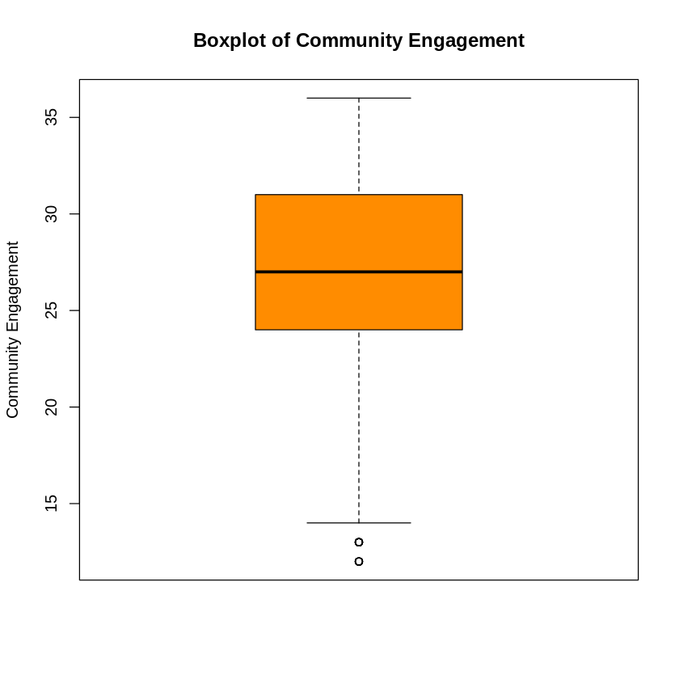
MULTIPLE LOGISTIC REGRESSION
Univariate Statistics for Community Engagement (X_{P2})
Descriptive Statistics Table
Histogram and Box Plot
Statistics
Community Engagement
N | Valid | 1,495
 | Missing | 0
Mean |  | 26.67
Median |  | 27.00
Std. Deviation |  | 5.1689
Minimum |  | 12.00
Maximum |  | 36.00
Percentiles | 25 | 24.00
 | 50 | 27.00
 | 75 | 36.00
Interpretation Statement
Among the 1,495 veterans, the 5-point summary for Community Engagement is (12, 24, 27, 36, 36)

Slide 72
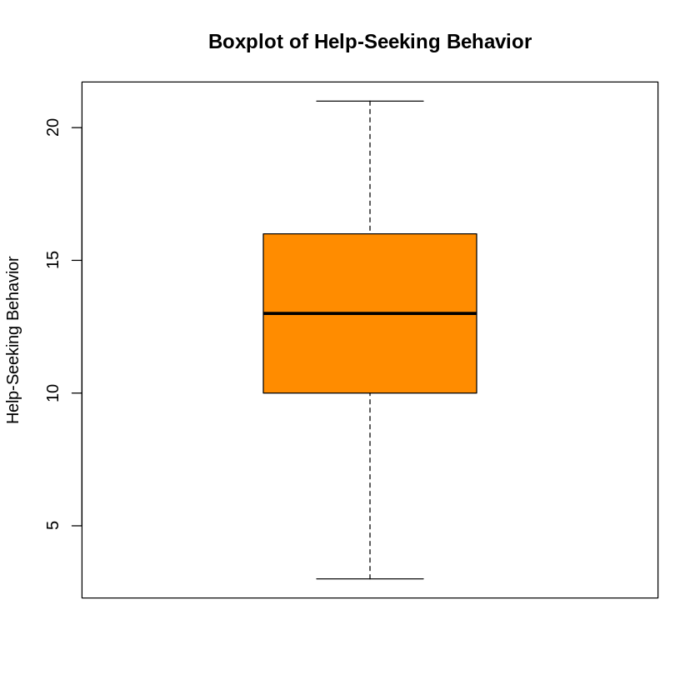
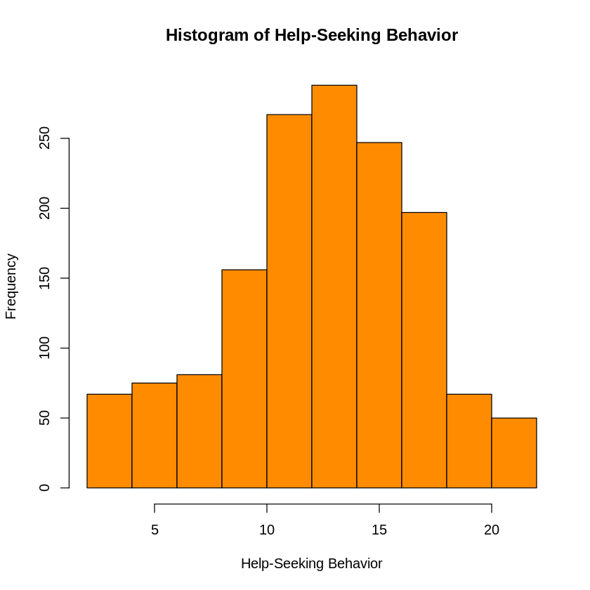
MULTIPLE LINEAR REGRESSION
Univariate Statistics for Help-Seeking Behavior (X_{P3})
Descriptive Statistics Table
Histogram and Box Plot
Statistics
Help-Seeking Behavior
N | Valid | 1,495
 | Missing | 0
Mean |  | 12.96
Median |  | 13.00
Std. Deviation |  | 4.2852
Minimum |  | 3.00
Maximum |  | 21.00
Percentiles | 25 | 10.00
 | 50 | 12.96
 | 75 | 21.00
Interpretation Statement
Among the 1,495 veterans, the 5-point summary for Help-Seeking Behavior is (3, 10, 13, 21, 21)

Slide 73
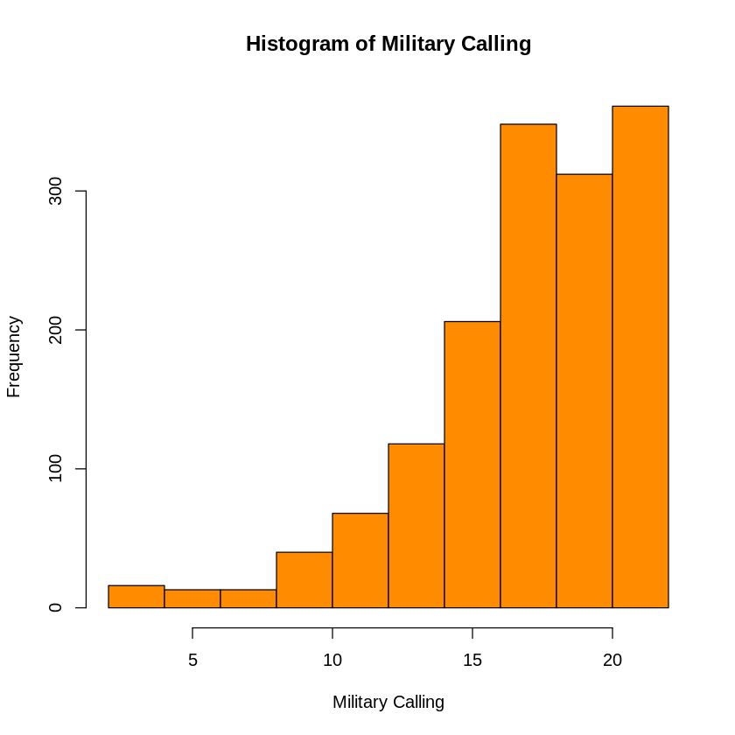
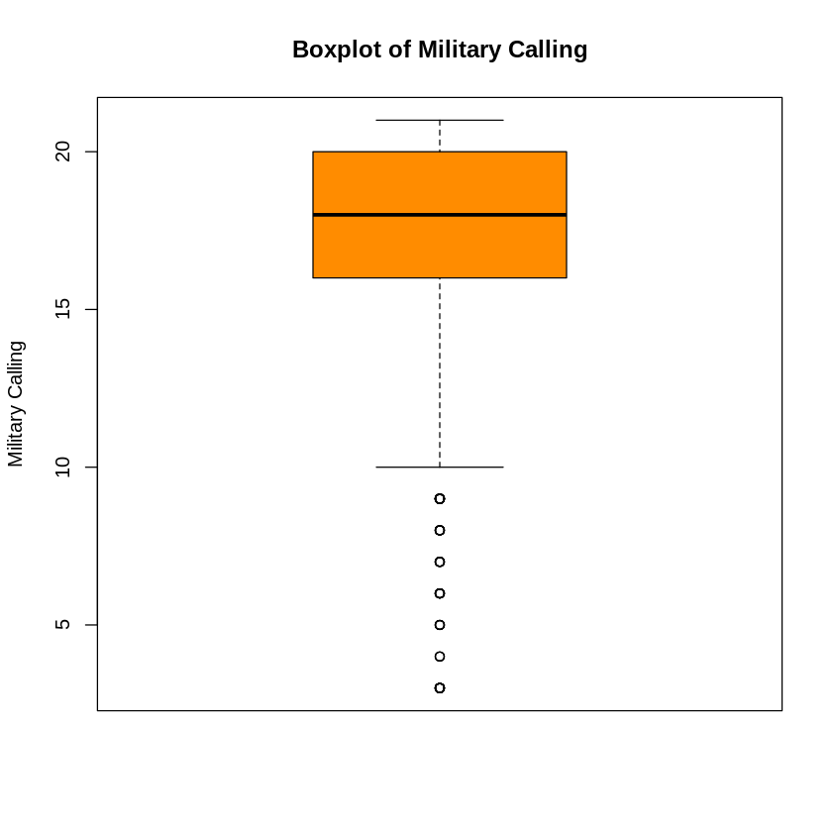
MULTIPLE LINEAR REGRESSION
Univariate Statistics for Military Calling (X_{P4})
Descriptive Statistics Table
Histogram and Box Plot
Statistics
Military Calling
N | Valid | 1,495
 | Missing | 0
Mean |  | 17.38
Median |  | 18.00
Std. Deviation |  | 3.6506
Minimum |  | 3.00
Maximum |  | 21.00
Percentiles | 25 | 16.00
 | 50 | 18.00
 | 75 | 20.00
Interpretation Statement
Among the 1,495, the 5-point summary for Military Calling is (3, 16, 18, 20, 21)

Slide 74
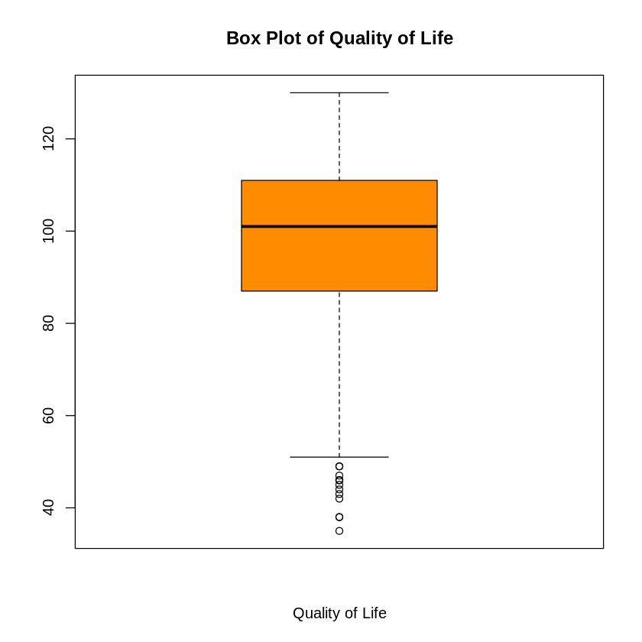
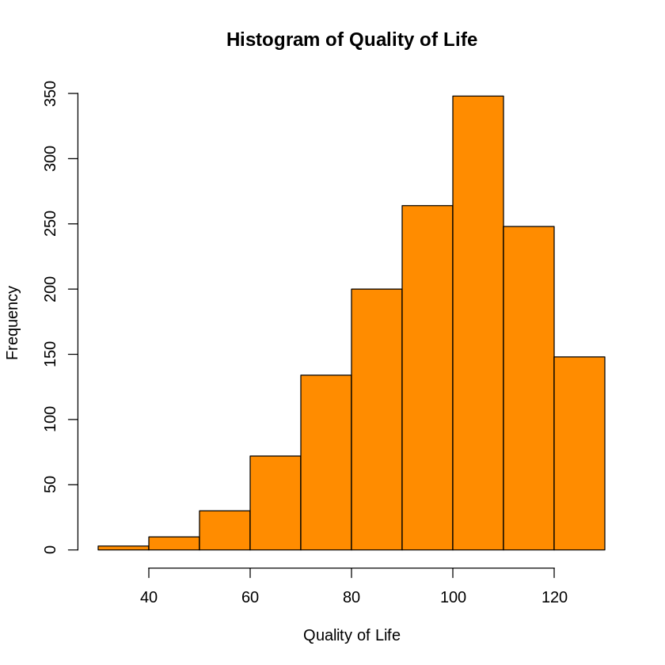
MULTIPLE LINEAR REGRESSION
Univariate Statistics for Quality of Life (X_{P5})
Descriptive Statistics Table
Histogram
Statistics
Quality of Life
N | Valid | 1,495
 | Missing | 0
Mean |  | 98.33
Median |  | 101.00
Std. Deviation |  | 17.9376
Minimum |  | 35.00
Maximum |  | 130.00
Percentiles | 25 | 87.00
 | 50 | 101.00
 | 75 | 111.00
Interpretation Statement
Among the 1,495 veterans, the 5-point summary for Quality of Life is (33, 87, 101, 111, 130)

Slide 75
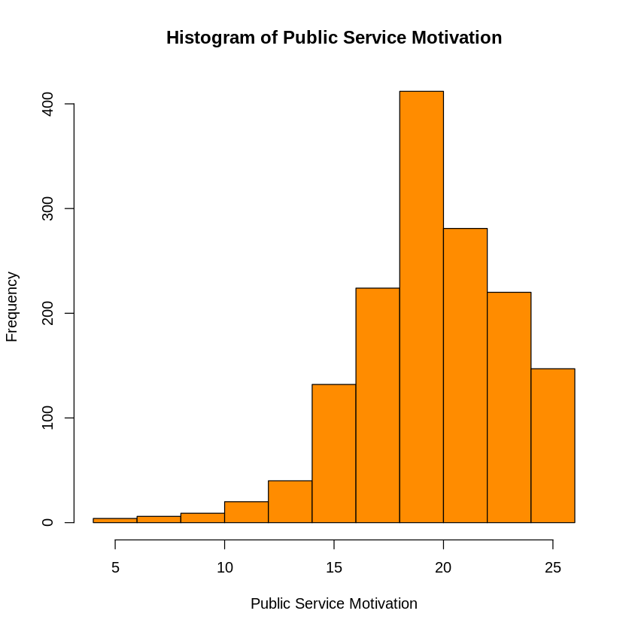
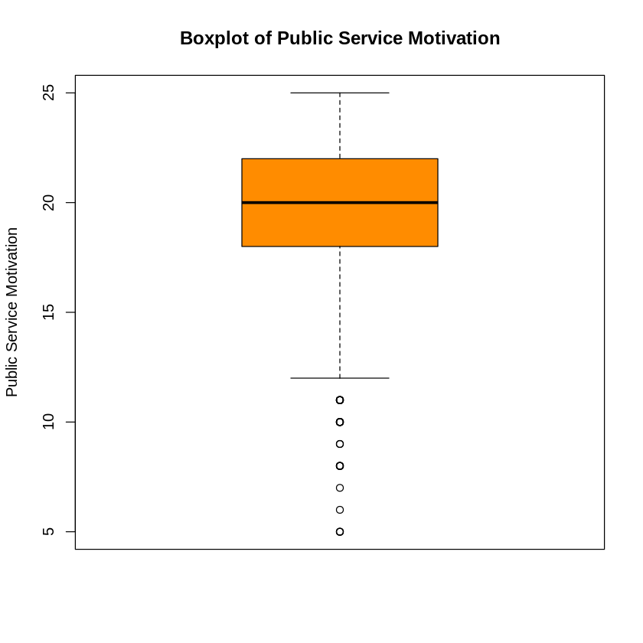
MULTIPLE LINEAR REGRESSION
Univariate Statistics for Public Service Motivation (X_{P6})
Descriptive Statistics Table
Histogram and Box Plot
Statistics
Public Service Motivation
N | Valid | 1,495
 | Missing | 0
Mean |  | 19.96
Median |  | 20.00
Std. Deviation |  | 3.3811
Minimum |  | 5.00
Maximum |  | 25.00
Percentiles | 25 | 18.00
 | 50 | 20.00
 | 75 | 22.00
Interpretation Statement
Among the 1,495, the 5-point summary for Public Service Motivation is (5, 18, 20, 22, 25)

Slide 76
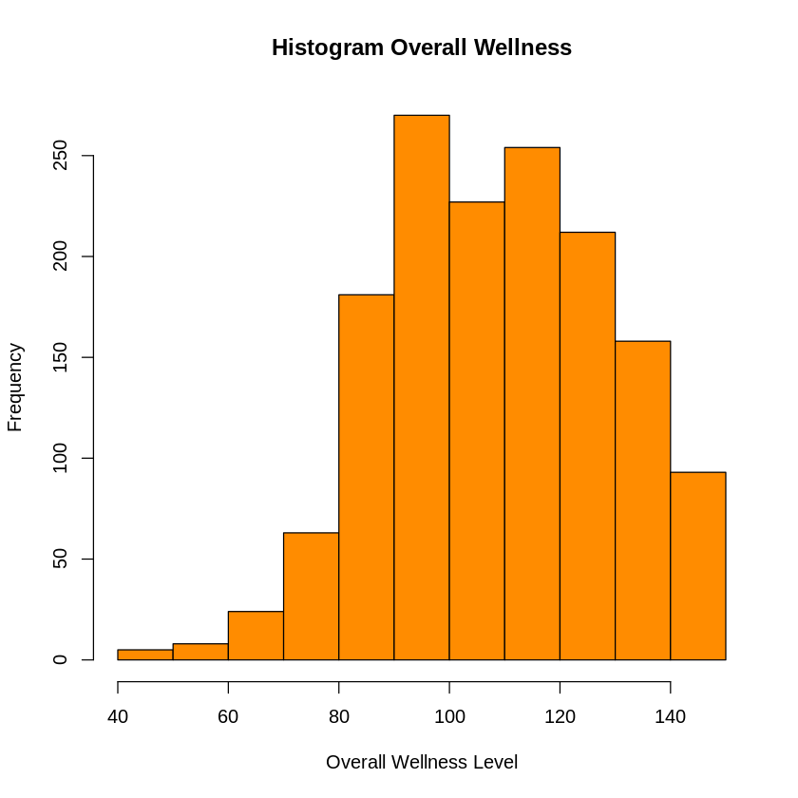
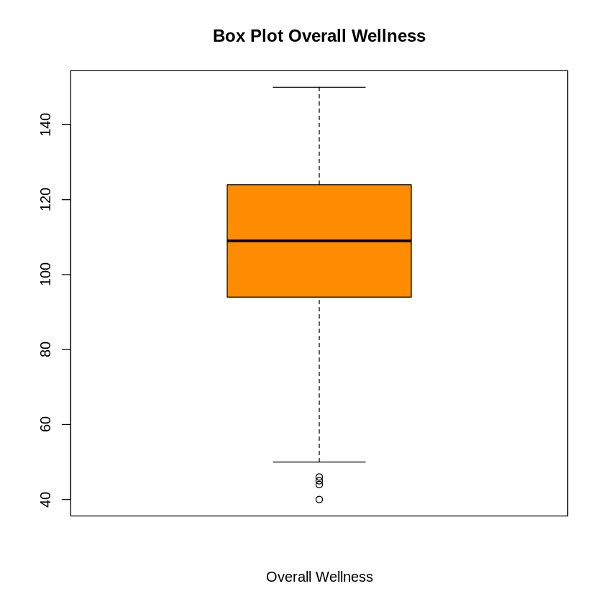
MULTIPLE LINEAR REGRESSION
Univariate Statistics for Wellness (X_{P7})
Descriptive Statistics Table
Histogram and Box Plot
Statistics
Wellness
N | Valid | 1,495
 | Missing | 0
Mean |  | 109.2
Median |  | 109.00
Std. Deviation |  | 20.1099
Minimum |  | 40.00
Maximum |  | 150.00
Percentiles | 25 | 94.00
 | 50 | 109.00
 | 75 | 124.00
Interpretation Statement
Among the 1,495, the mean and standard deviation for Overall Wellness are 109.20 and 20.11, respectively.

Slide 77
MULTIPLE LINEAR REGRESSION
Pearson’s Correlations Between all Model 1 Protective Factor* and Alcohol and Drug Abuse Risk
 | Alcohol and Drug Abuse Risk | Calling and Purpose | Community Engagement | Help-Seeking Behavior | Military Calling | Quality of Life | Public Service Motivation | Overall Wellness
Alcohol and Drug Abuse Risk | 1.00
Calling and Purpose | -0.01 | 1.00
Community Engagement | -0.22 | 0.28 | 1.00
Help-Seeking Behavior | 0.00 | 0.29 | 0.46 | 1.00
Military Calling | -0.06 | 0.36 | 0.20 | 0.23 | 1.00
Quality of Life | -0.33 | 0.17 | 0.61 | 0.28 | 0.13 | 1.00
Public Service Motivation | 0.00 | 0.58 | 0.23 | 0.30 | 0.58 | 0.11 | 1.00
Overall Wellness | -0.34 | 0.27 | 0.71 | 0.29 | 0.20 | 0.78 | 0.22 | 1.00
*Calling and Purpose, Community Engagement, Help-Seeking Behaviors, Military Calling, Quality of Life Score, Public Service Motivation and Wellness

Slide 78
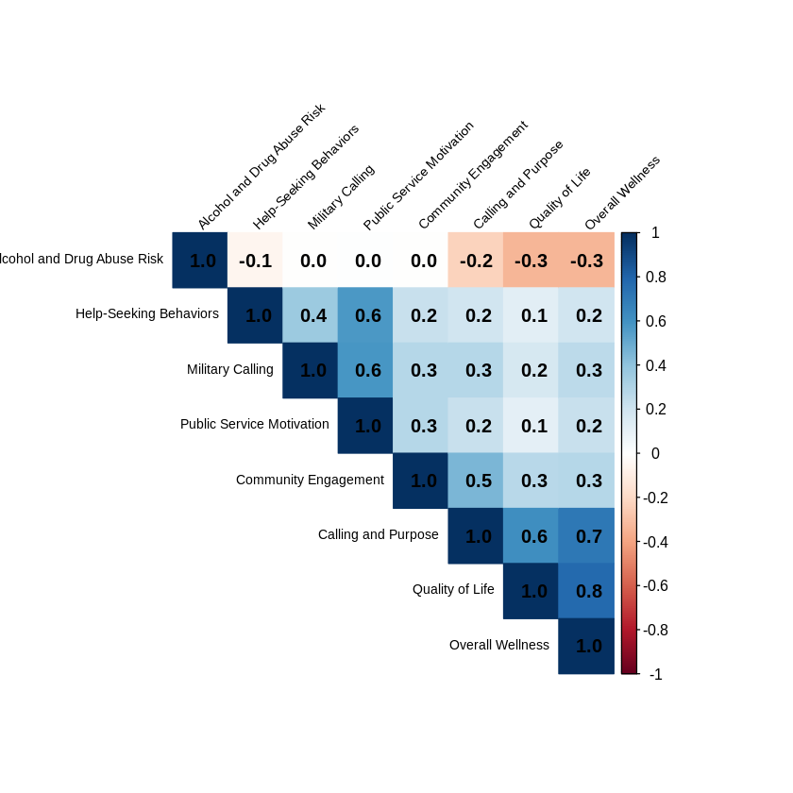
MULTIPLE LINEAR REGRESSION
Correlation Plot Between All Model 1 Protective Factor* and Alcohol and Drug Abuse Risk
*Calling and Purpose, Community Engagement, Help-Seeking Behaviors, Military Calling, Quality of Life Score, Public Service Motivation and Wellness

Slide 79
MULTIPLE LINEAR REGRESSION
Dendrogram for Protective Factors
Interpretation Statement The dendrogram suggests there may be collinearity between Quality of Life and Overall Wellness and between Military Calling and Public Service Motivation.

Slide 80
MULITPLE LINEAR REGRESSION Model 1 Summary Tables
TABLE 2: Variance Inflation Factors for the Model 1 Protective Factors* among Veterans in The 2022 Military Health and Well-Being Project from ICPSR Michigan (N=1,495)
Measures | Variance Inflation Factors
Calling and Purpose | 1.594
Community Engagement | 2.388
Help-Seeking Behavior | 1.359
Military Calling | 1.531
Quality of Life | 2.628
Public Service Motivation | 2.038
Overall Wellness | 3.385
*Calling and Purpose, Community Engagement, Help-Seeking Behaviors, Military Calling, Quality of Life Score, Public Service Motivation and Wellness
Interpretation Statement The Variance Inflation Factors (VIF) for the Protective Factors for Alcohol and Drug Abuse are below 5. Therefore, it suggests a moderate or low correlation between predictor variables, indicating that multicollinearity is unlikely to significantly impact the regression model. However, the highest VIF value (3.385) suggests some degree of correlation, but it is still within an acceptable range.
Notes:
*

Slide 81
MULITPLE LINEAR REGRESSION
Regression Analysis Model 1 Protective Factors
R and R²
Model Summary
Model | R | R Square | Adjusted R Square | Std. Error of the Estimate
1 | 0.3812ª | 0.1453 | 0.1412 | 1.215
a. Predictors: (Constant), Calling and Purpose, Community Engagement, Help-Seeking Behaviors, Military Calling, Quality of Life Score, Public Service Motivation and Wellness
Interpretation Statements There is no correlation between Alcohol and Drug Abuse and Calling and Purpose, Community Engagement, Help-Seeking Behaviors, Military Calling, Quality of Life Score, Public Service Motivation and Wellness (R = 0.381). 14.1 % of the variance in Alcohol and Drug Abuse is explained by Calling and Purpose, Community Engagement, Help-Seeking Behaviors, Military Calling, Quality of Life Score, Public Service Motivation, and Wellness.

Slide 82
MULITPLE LINEAR REGRESSION
Regression Analysis for Model 1
Regression Equation with Legend
Equation: Y = 2.999 + 0.020*X_{P1} + 0.001*X_{P2} + 0.031*X_{P3} -0.020*X_{P4} – 0.013*X_{P5} + 0.021*X_{P6} – 0.0159*X_{P7} + e Legend: Y = Alcohol and Drug Abuse Risk X_{P1} = Calling and Purpose X_{P2} = Community Engagement X_{P3} = Help-Seeking Behavior X_{P4} = Military Calling X_{P5} = Quality of Life X_{P6} = Public Service Motivation X_{P7} = Overall Wellness e = error term
Coefficientsª
Model |  | Coefficients |  | t | Sig.
 |  | B | Std. Error
1 | (Constant) | 2.999 | 0.267 | 11.197
 | Calling and Purpose | 0.020 | 0.013 | 1.552 | 0.121
 | Community Engagement | 0.001 | 0.009 | 0.119 | 0.906
 | Help-Seeking Behavior | 0.031 | 0.009 | 3.590 | <0.001
 | Military Calling | -0.020 | 0.011 | -1.971 | 0.059
 | Quality of Life Score | -0.013 | 0.003 | -4.610 | <0.001
 | Public Service Motivation | 0.021 | 0.013 | 1.538 | 0.124
 | Overall Wellness | -0.0159 | 0.003 | -5.486 | <0.001
a. Dependent Variable: Alcohol and Drug Abuse

Slide 83
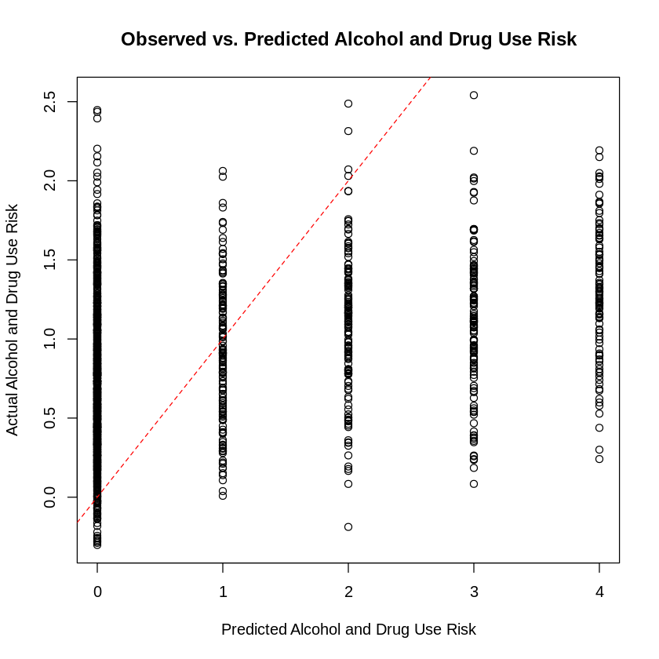
MULITPLE LINEAR REGRESSION
REGRESSION DIAGNOSTICS
Y versus Y –estimate Scatterplot?
Interpretation Statement There is no strong positive linear pattern. Hence, this model is NOT a good predictor of Y.

Slide 84
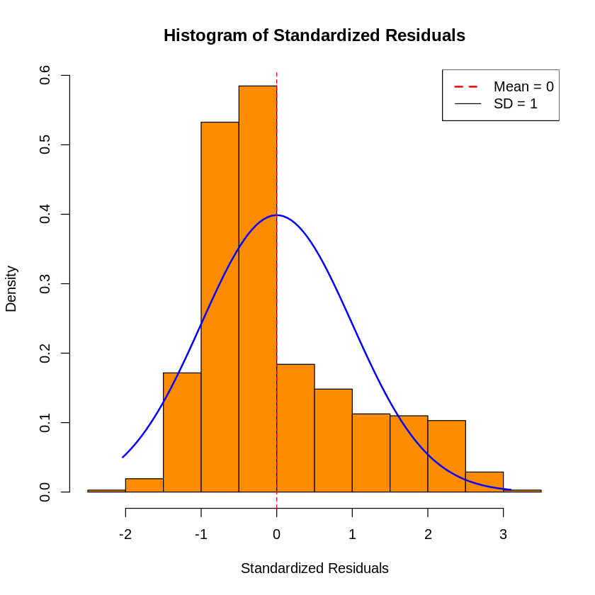
MULITPLE LINEAR REGRESSION
REGRESSION DIAGNOSTICS
Standardized Error Terms Histogram
Interpretation Statement Error terms are small. The mean is close to 0, with most values are between -2 and 2. The histogram for the STDE is not bell-shaped and symmetric. Therefore, this model is NOT a good predictor of Y.

Slide 85
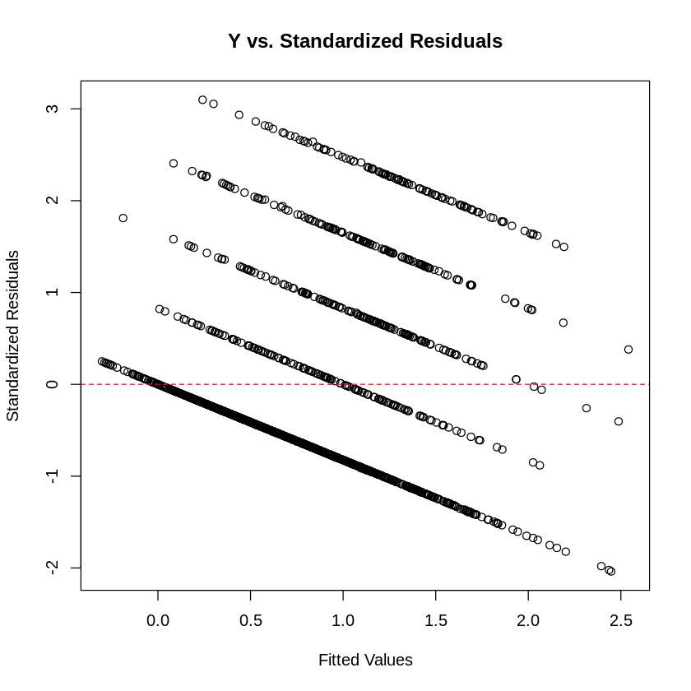
MULITPLE LINEAR REGRESSION
REGRESSION DIAGNOSTICS
Y versus Standardized Error Terms Scatterplot?
Interpretation Statement The scatterplot does not show a pattern. Y increases as STDE decreases. Most of the STDE terms are between (-2, 2). Hence, this model is NOT a good predictor of Y.

Slide 86
MULITPLE LINEAR REGRESSION MODEL 1 SUMMARY TABLES
TABLE 1: Descriptive Statistics and Bivariate Associations between Alcohol Abuse Risk and Model 1 Protective Factor* among Veterans in The 2022 Military Health and Well-Being Project from ICPSR Michigan (N=1,495)
 | Overall
 | N | Mean (SD) | Test and p-value
Alcohol and Drug Abuse Risk | 1,495
Calling and Purpose (scale) | 1,495 | 20.24 (3.2) | Pearson’s Correlation = 0.121
Community Engagement (scale) | 1,495 | 26.7 (5.2) | Pearson’s Correlation = 0.906
Help-Seeking Behavior (scale) | 1,495 | 13.0 (4.3) | Pearson’s Correlation < 0.001**
Military Calling (scale) | 1,495 | 17.4 (3.7) | Pearson’s Correlation = 0.059
Quality of Life (scale) | 1,495 | 98.3 (17.9) | Pearson’s Correlation <0.001**
Public Service Motivation (scale) | 1,495 | 20.0 (3.4) | Pearson’s Correlation = 0.124
Overall Wellness (scale) | 1,495 | 109.2 (20.1) | Pearson’s Correlation <0.001**
**Denote p value < 0.5
* Calling and Purpose, Community Engagement, Help-Seeking Behaviors, Military Calling, Quality of Life, Public Service Motivation and Wellness

Slide 87
MULITPLE LINEAR REGRESSION MODEL 1 SUMMARY TABLES
TABLE 2: Protective Factors* Independently Associated with Alcohol and Drug Abuse Risk using Multiple Linear Regression among Veterans in The 2022 Military Health and Well-Being Project from ICPSR Michigan (N=1,495)
Measures | ß | p-value
Constant | 2.999 |  |  | R= | 0.381
 |  |  |  | R²= | 0.1452
 |  |  |  | Overall p-value | <0.001
Calling and Purpose (scale) | 0.0198 | 0.121
Community Engagement (Scale) | 0.0011 | 0.906
Help-Seeking Behavior (Scale) | 0.0311 | <0.001 | #
Military Calling (Scale) | -0.0202 | 0.0598
Quality of Life (Scale) | -0.1327 | <0.001 | #
Public Service Motivation (Scale) | 0.0206 | 0.124
Overall Wellness (Scale) | -0.0159 | <0.001 | #
# Denotes p-value < 0.05
*Calling and Purpose, Community Engagement, Help-Seeking Behaviors, Military Calling, Quality of Life Score, Public Service Motivation and Overall Wellness
Notes:
O*

Slide 88
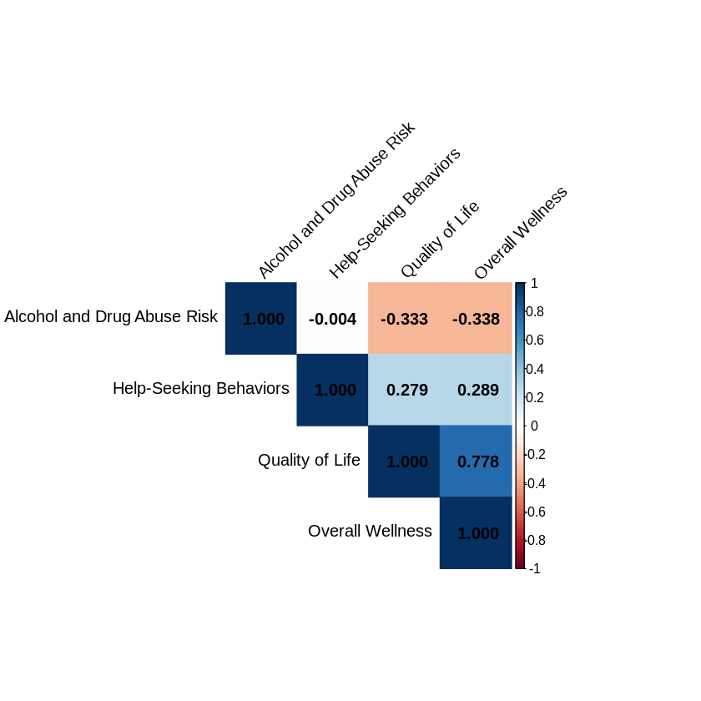
MULTIPLE LINEAR REGRESSION
Correlation Plot Between All Model 1 Statistically Significant Protective Factors and Alcohol and Drug Abuse Risk
Model 2
*Help-Seeking Behaviors, Quality of Life Score, and Overall Wellness

Slide 89
MULTIPLE LINEAR REGRESSION
Pearson’s Correlations Between All Model 2 Protective Factors and Alcohol and Drug Abuse Risk
 | Alcohol and Drug Abuse Risk | Help-Seeking Behavior | Quality of Life | Overall Wellness
Alcohol and Drug Abuse Risk | 1.000
Help-Seeking Behavior | -0.000 | 1.000
Quality of Life | -0.333 | 0.279 | 1.000
Overall Wellness | -0.340 | 0.288 | 0.778 | 1.000
*Help-Seeking Behaviors, Quality of Life Score, and Overall Wellness

Slide 90
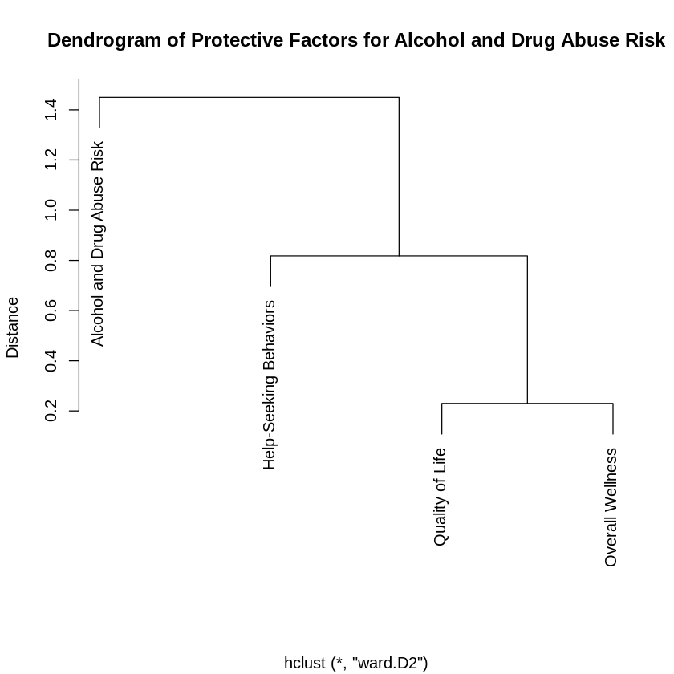
MULTIPLE LINEAR REGRESSION
Dendrogram for Model 2 Protective Factors
Interpretation Statement The dendrogram suggests there may be collinearity between Quality of Life and Overall Wellness.

Slide 91
MULITPLE LINEAR REGRESSION Summary Tables
TABLE 3: Model 2 Protective Factors * Independently Associated with Alcohol and Drug Abuse Risk using Multiple Linear Regression among Veterans in The 2022 Military Health and Well-Being Project from ICPSR Michigan (N=1,495)
Measures | Variance Inflation Factors
Help-Seeking Behavior | 1.100
Quality of Life | 2.555
Overall Wellness | 2.569
*Help-Seeking Behaviors, Quality of Life Score, and Overall Wellness
Interpretation Statement The Variance Inflation Factors (VIF) for the Protective Factors for Alcohol and Drug Abuse are below 5. Therefore, it suggests a moderate or low correlation between predictor variables, indicating that multicollinearity is unlikely to significantly impact the regression model. However, the highest VIF value (3.385) suggests some degree of correlation, but it is still within an acceptable range.
Notes:
*

Slide 92
MULITPLE LINEAR REGRESSION
Regression Analysis Model 2 Protective Factors
R and R²
Model Summary
Model | R | R Square | Adjusted R Square | Std. Error of the Estimate
1 | 0.3740ª | 0.1399 | 0.1381 | 1.218
a. Predictors: (Constant), Help-Seeking Behaviors, Quality of Life Score, and Overall Wellness
Interpretation Statements There is no correlation between Alcohol and Drug Use and Help-Seeking Behaviors, Quality of Life Score, and Overall Wellness (R = 0.381). 14.1 % of the variance in Alcohol and Drug Use is explained by Help-Seeking Behaviors, Quality of Life Score, and Overall Wellness.

Slide 93
MULITPLE LINEAR REGRESSION
Regression Analysis For Model 2
Regression Equation with Legend
Equation: Y = 2.999 + + 0.036*X_{P3} – 0.014*X_{P5} – 0.015*X_{P7} + e Legend: Y = Alcohol and Drug Abuse Risk X_{P1} = Calling and Purpose X_{P2} = Community Engagement X_{P3} = Help-Seeking Behavior X_{P4} = Military Calling X_{P5} = Quality of Life X_{P6} = Public Service Motivation X_{P7} = Overall Wellness e = error term
Interpretation Statement No difference in Model 1 and 2
Coefficientsª
Model 2 (Reduced model from saturated regression to include only those with statistical significance in model 1) |  | Coefficients |  | t | Sig.
 |  | B | Std. Error
1 | (Constant) | 3.3580 | .01921 | 17.480
 | Calling and Purpose
 | Community Engagement
 | Help-Seeking Behavior | 0.036 | 0.008 | 4.614 | <0.001
 | Military Calling
 | Quality of Life Score | -0.014 | 0.003 | -4.894 | <0.001
 | Public Service Motivation
 | Overall Wellness | -0.015 | 0.003 | -5.782 | <0.001
a. Dependent Variable: Alcohol and Drug Abuse

Slide 94
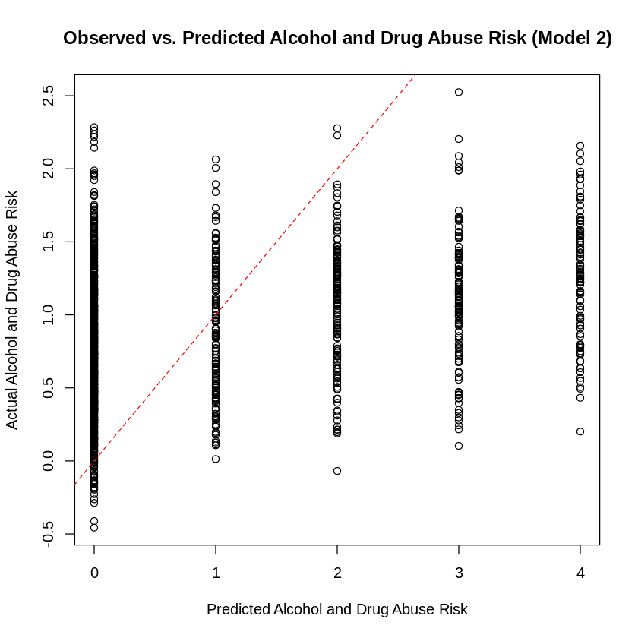
MULITPLE LINEAR REGRESSION
Regression Diagnostics for Model 2
Y versus Y –estimate Scatterplot?
Interpretation Statement There is no strong positive linear pattern. Hence, this model is NOT a good predictor of Y.

Slide 95
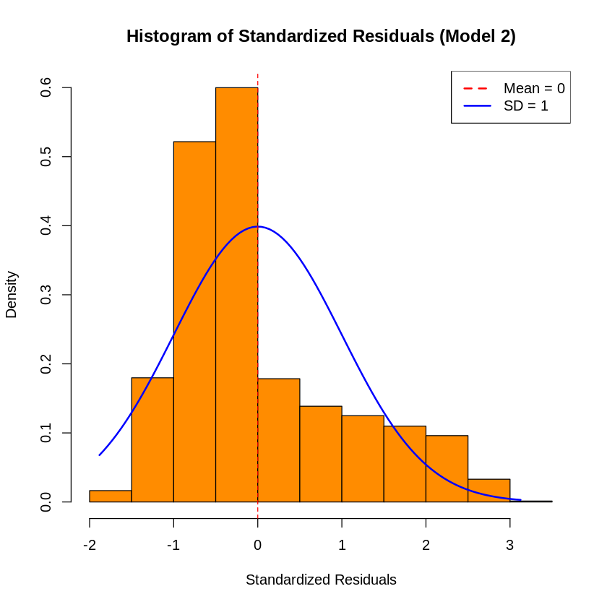
MULITPLE LINEAR REGRESSION
Regression Diagnostics for Model 2
Standardized Error Terms Histogram
Interpretation Statement Error terms are small. The mean is close to 0, with most values are between -2 and 2. The histogram for the STDE is not bell-shaped and symmetric. Therefore, this model is NOT a good predictor of Y.

Slide 96
Negative Risk Factors
(X_{N1} through X_{N7})

Slide 97
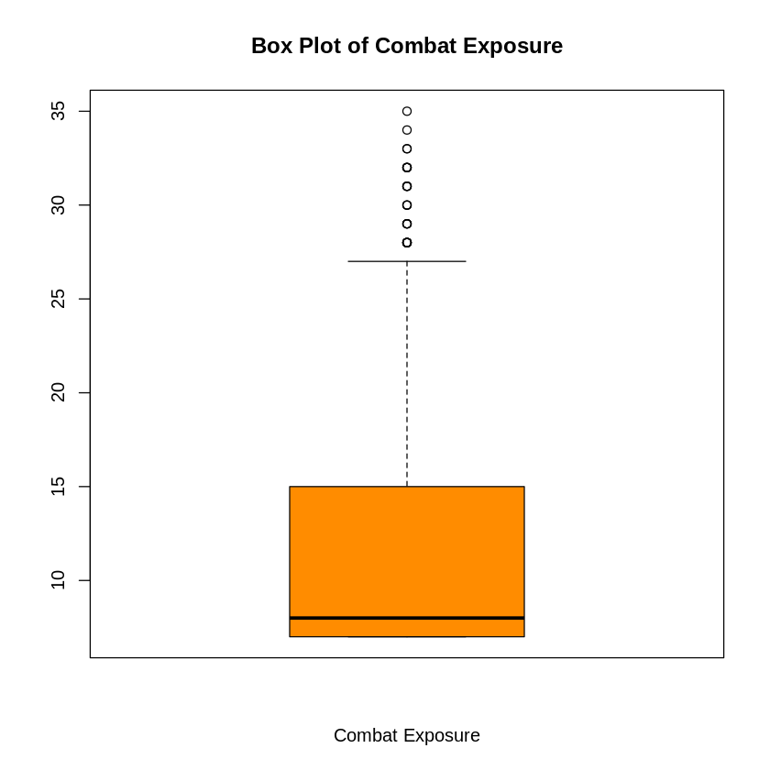
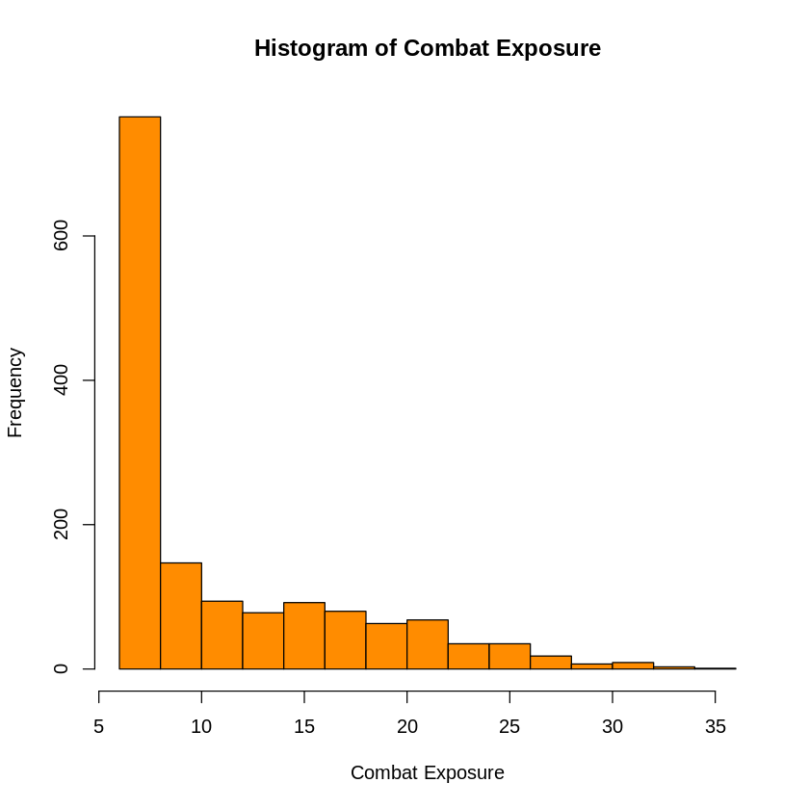
MULTIPLE LINEAR REGRESSION
Univariate Statistics for Combat Exposure (X_{N1})
Descriptive Statistics Table
Histogram and Box Plot
Statistics
Combat Exposure
N | Valid | 1,495
 | Missing | 0
Mean |  | 11.58
Median |  | 8.00
Std. Deviation |  | 6.0553
Minimum |  | 7.00
Maximum |  | 35.00
Percentiles | 25 | 7.00
 | 50 | 8.00
 | 75 | 15.00
Interpretation Statement
Among the 1,495 veterans, the 5-point summary for Combat Exposure is (7, 7, 8, 15, 35)
Notes:
77888888888

Slide 98
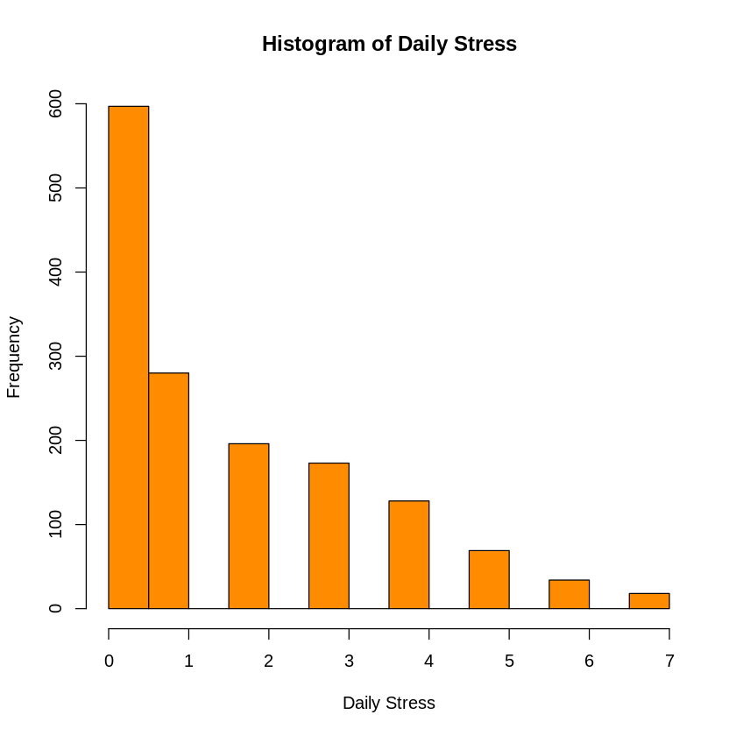
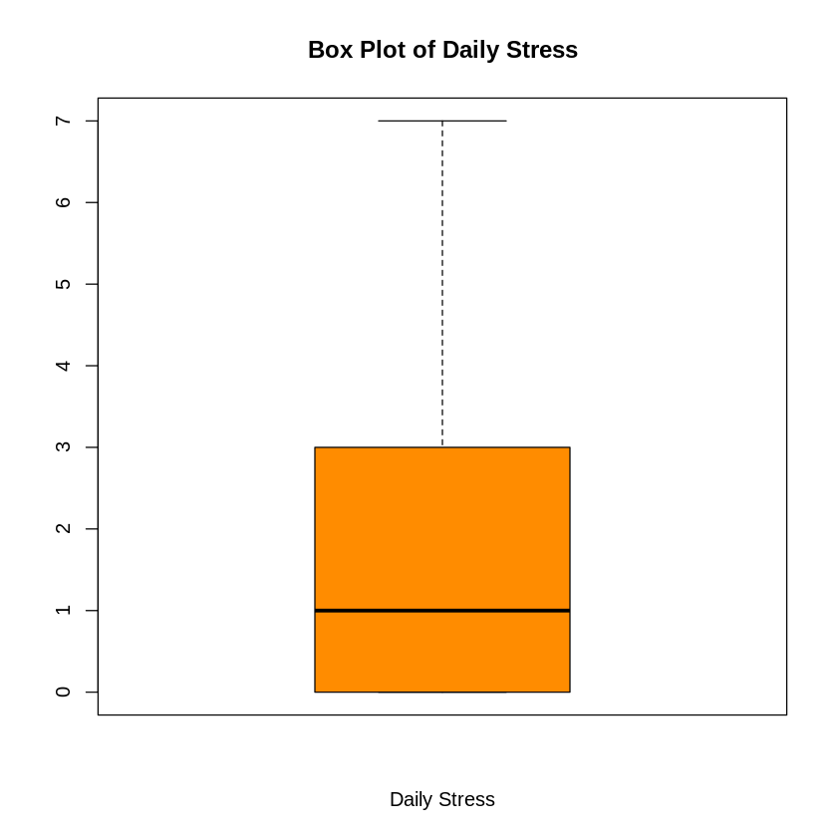
MULTIPLE LINEAR REGRESSION
Univariate Statistics for Daily Stress (X_{N2})
Descriptive Statistics Table
Histogram and Box Plot
Statistics
Daily Stress
N | Valid | 1,495
 | Missing | 0
Mean |  | 1.591
Median |  | 1.00
Std. Deviation |  | 1.7770
Minimum |  | 0.00
Maximum |  | 7.00
Percentiles | 25 | 0.00
 | 50 | 1.00
 | 75 | 3.00
Interpretation Statement
Among the 1,495 veterans, the 5-point summary for Daily Stress is (0, 0, 1, 3, 7)

Slide 99
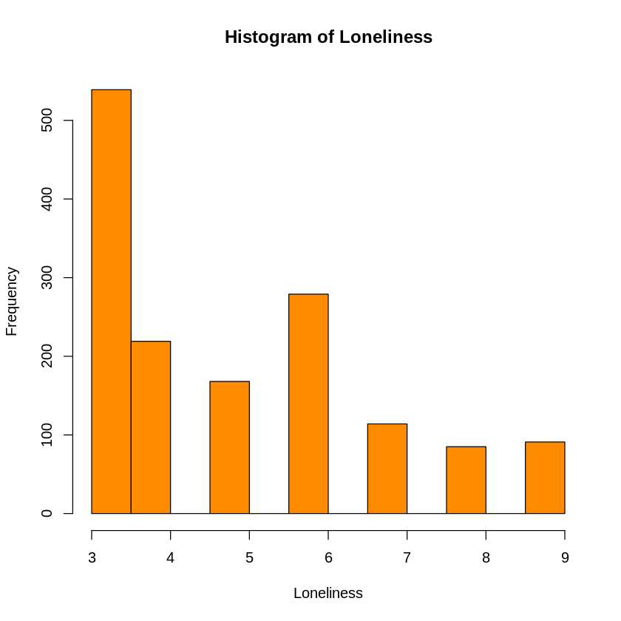

MULTIPLE LINEAR REGRESSION
Univariate Statistics for Loneliness (X_{N3})
Descriptive Statistics Table
Histogram and Box Plot
Statistics
Loneliness
N | Valid | 1,495
 | Missing | 0
Mean |  | 4.886
Median |  | 4.00
Std. Deviation |  | 1.886
Minimum |  | 3.00
Maximum |  | 9.00
Percentiles | 25 | 3.00
 | 50 | 4.00
 | 75 | 6.00
Interpretation Statement
Among the 1,495 veterans, the 5-point summary for Loneliness is (3, 3, 4, 6, 9)

Slide 100
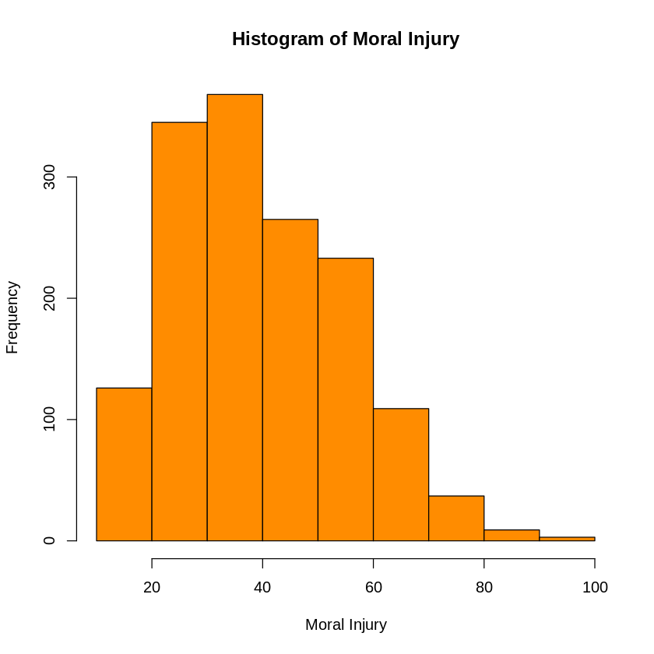
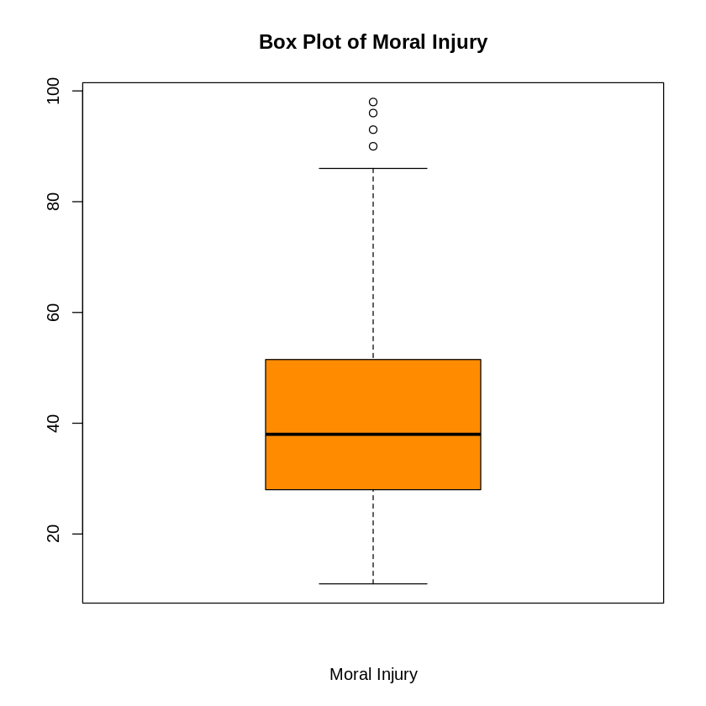
MULTIPLE LINEAR REGRESSION
Univariate Statistics for Moral Injury (X_{N4})
Descriptive Statistics Table
Histogram and Box Plot
Statistics
Moral Injury
N | Valid | 1,495
 | Missing | 0
Mean |  | 40.13
Median |  | 38.00
Std. Deviation |  | 15.3149
Minimum |  | 11.00
Maximum |  | 98.00
Percentiles | 25 | 28.00
 | 50 | 38.00
 | 75 | 51.50
Interpretation Statement
Among the 1,495 veterans, the 5-point summary for Moral Injury is (11, 28, 38, 51.5, 98)

Slide 101
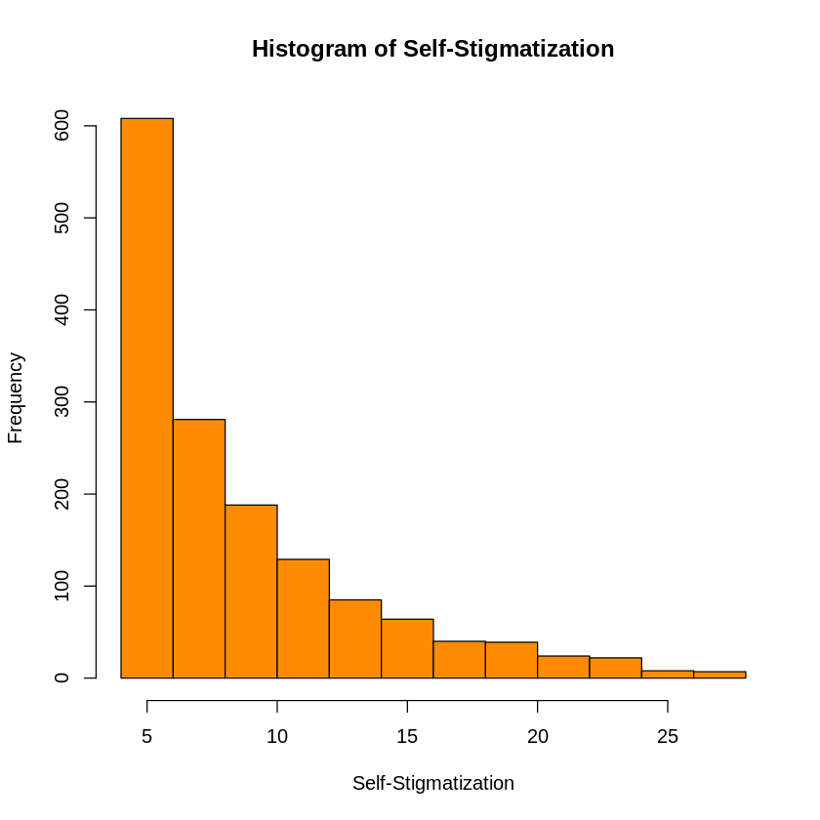

MULTIPLE LINEAR REGRESSION
Univariate Statistics for Self-Stigmatization (X_{N5})
Descriptive Statistics Table
Histogram and Box Plot
Statistics
Self-Stigmatization
N | Valid | 1,495
 | Missing | 0
Mean |  | 8.80
Median |  | 7.00
Std. Deviation |  | 5.1066
Minimum |  | 4.00
Maximum |  | 28.00
Percentiles | 25 | 4.00
 | 50 | 7.00
 | 75 | 11.00
Interpretation Statement
Among the 1,495 veterans, the 5-point summary for Self-Stigmatization is (4, 4, 7, 11, 28)

Slide 102
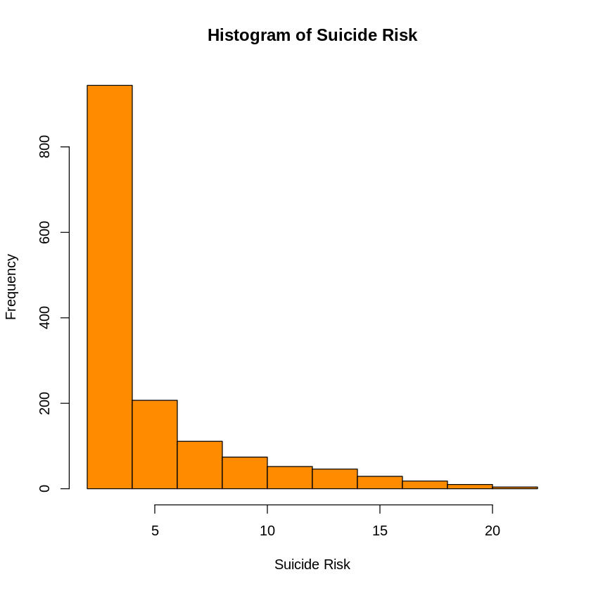
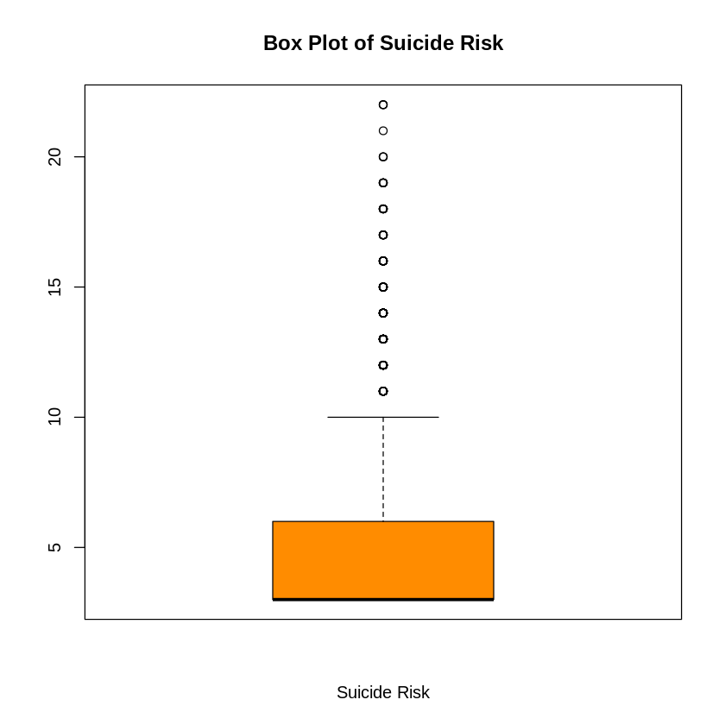
MULTIPLE LINEAR REGRESSION
Univariate Statistics for Suicide Risk (X_{N7})
Descriptive Statistics Table
Histogram and Box Plot
Statistics
Suicide Risk
N | Valid | 1,495
 | Missing | 26*
Mean |  | 5.298
Median |  | 3.00
Std. Deviation |  | 3.6770
Minimum |  | 3.00
Maximum |  | 22.00
Percentiles | 25 | 3.00
 | 50 | 3.00
 | 75 | 6.00
*Mean was imputed for missing values
Interpretation Statement
Among the 1,495 veterans, the 5-point summary for Suicide Risk is (3, 3, 3, 6, 22)

Slide 103
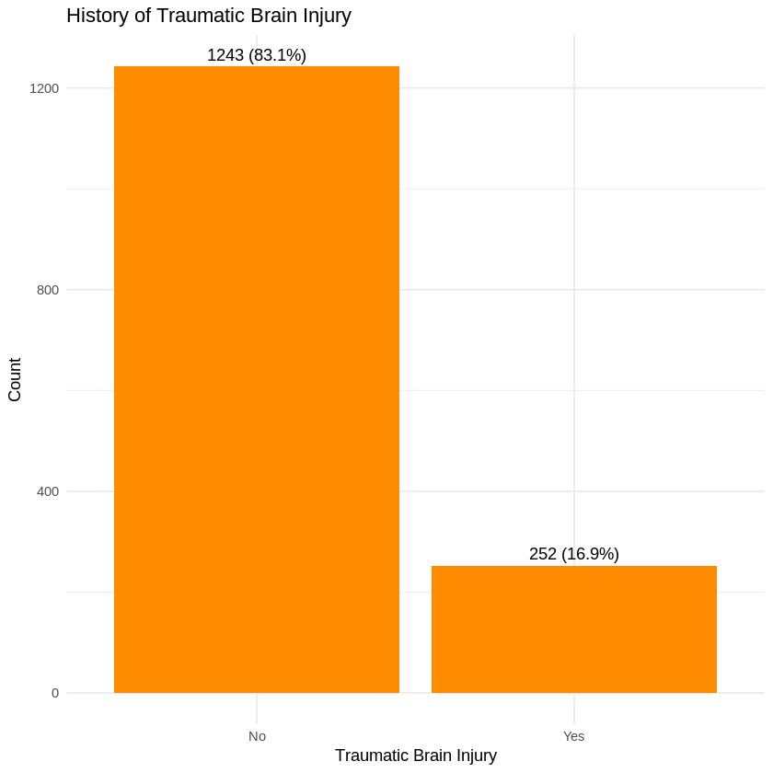
MULTIPLE LOGISTIC REGRESSION
Univariate Statistics for History of Traumatic Brain Injury (X_{N7})
Descriptive Statistics Table
Bar Plot
History of Traumatic Brain Injury
 | Frequency | Percent | Valid Percent | Cumulative Percent
No | 1243 | 83.1 | 83.1 | 83.1
Yes | 252 | 16.9 | 16.9 | 100.0
Total | 1,495 | 100.0 | 100.0
Interpretation Statement
Among the 1,495 veterans, 83.1% have a history of a Traumatic Brain Injury, while 16.9% did not.

Slide 104
MULTIPLE LINEAR REGRESSION
Pearson’s Correlations Between all Model 3 Risk Factor *
 | Alcohol and Drug Abuse Risk | Combat Exposure | Daily Stress | Loneliness | Moral Injury | Self-Stigmatization | Suicide Risk | History of Traumatic Brain Injury
Alcohol and Drug Abuse Risk | 1.00
Combat Exposure | 0.24 | 1.00
Daily Stress | 0.36 | 0.31 | 1.00
Loneliness | 0.33 | 0.20 | 0.33 | 1.00
Moral Injury | 0.42 | 0.33 | 0.44 | 0.54 | 1.00
Self-Stigmatization | 0.22 | 0.25 | 0.30 | 0.23 | 0.46 | 1.00
Suicide Risk | 0.40 | 0.22 | 0.33 | 0.41 | 0.51 | 0.21 | 1.00
History of Traumatic Brain Injury | 0.14 | 0.18 | 0.18 | 0.16 | 0.19 | 0.10 | 0.20 | 1.00
*Combat Exposure, Daily Stress, Loneliness, Moral Injury, Self-Stigmatization, Suicide Risk, and History of Traumatic Brain Injury

Slide 105
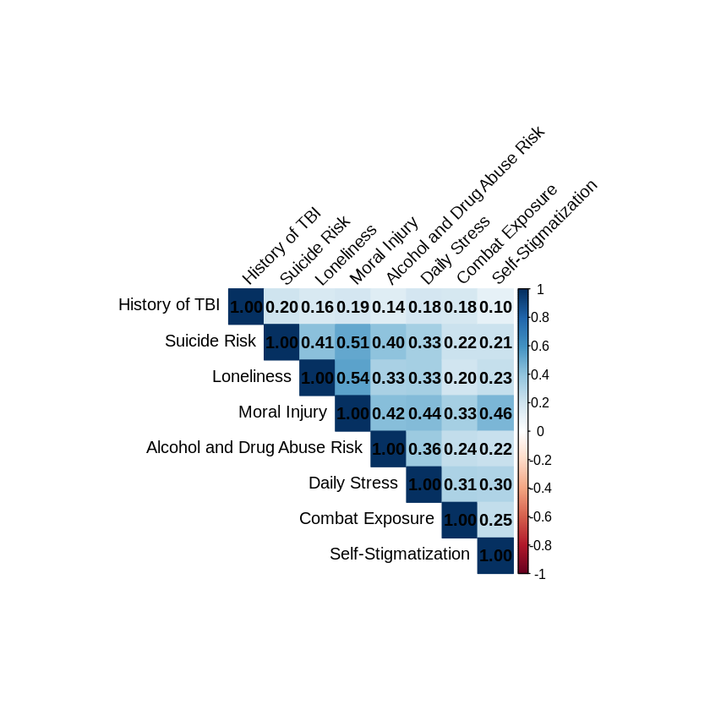
MULTIPLE LINEAR REGRESSION
Correlation Plot Between all Model 3 Risk Factors*
*Combat Exposure, Daily Stress, Loneliness, Moral Injury, Self-Stigmatization, Suicide Risk, and History of Traumatic Brain Injury

Slide 106
MULITPLE LINEAR REGRESSION
Regression Analysis Model 3 Risk Factors
R and R²
Model Summary
Model 3 | R | R Square | Adjusted R Square | Std. Error of the Estimate
1 | 0.4913ª | 0.2414 | 0.2383 | 1.144
a. Predictors: (Constant), Combat Exposure, Loneliness, Moral Injury, Self-Stigmatization, Suicide Risk, History of Traumatic Brain Injury
Interpretation Statements There is no correlation between Alcohol and Drug Abuse Risk and Combat Exposure, Loneliness, Moral Injury, Self-Stigmatization, Suicide Risk, and History of Traumatic Brain Injury (R = 0.491). 23.8 % of the Variance in Alcohol and Drug Abuse Risk is explained by Combat Exposure, Loneliness, Moral Injury, Self-Stigmatization, Suicide Risk, and History of Traumatic Brain Injury

Slide 107
MULITPLE LINEAR REGRESSION
Regression Analysis Model 3
Regression Equation with Legend
Equation: Y = -0.787 + 0.015*X_{N1} + 0.121*X_{N2} + 0.0.54*X_{N3} + 0.014*X_{N4} + 0.004*X_{N5} + 0.076*X_{N6} + 0.014*X_{N7} + e Legend: Y = Alcohol and Drug Abuse Risk X_{P1} = Combat Exposure X_{P2} = Daily Stress X_{P3} = Loneliness X_{P4} = Moral Injury X_{P5} = Self-Stigmatization X_{P6} = Suicide Risk X_{P7} = History of Traumatic Brain Injury e = error term
Coefficientsª
Model 3 |  | Coefficients |  | t | Sig.
 |  | B | Std. Error
1 | (Constant) | -0.787 | 0.101 | -7.824
 | Combat Exposure | 0.015 | 0.005 | 2.906 | <0.001
 | Daily Stress | 0.121 | 0.019 | 6.326 | 0.004
 | Loneliness | 0.054 | 0.019 | 2.845 | <0.001
 | Moral Injury | 0.014 | 0.003 | 5.169 | <0.001
 | Self-Stigmatization | 0.004 | 0.007 | 0.688 | 0.492
 | Suicide Risk | 0.076 | 0.010 | 7.952 | <0.001
 | History of Traumatic Brain Injury | 0.014 | 0.081 | 0.169 | 0.866
a. Dependent Variable: Alcohol and Drug Abuse
Notes:
0.0137

Slide 108
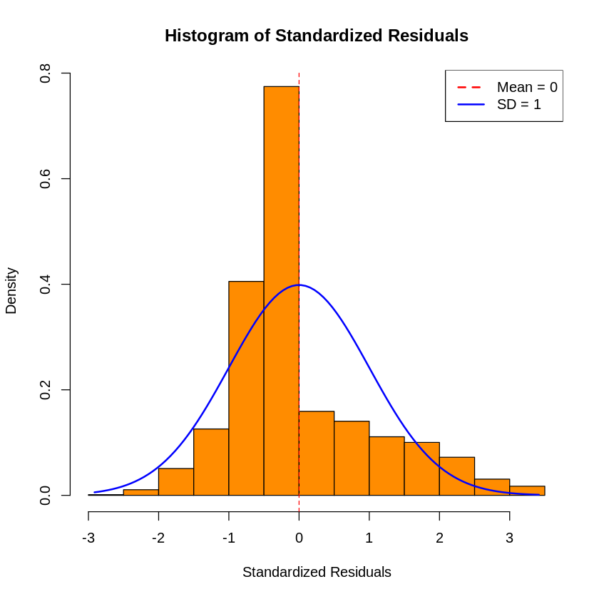
MULITPLE LINEAR REGRESSION
Model 3 Regression Diagnostics
Standardized Error Terms Histogram
Interpretation Statement Error terms are small. The mean is close to 0, with most values are between -2 and 2. The histogram for the STDE is not bell-shaped and symmetric. Therefore, this model is NOT a good predictor of Y.

Slide 109
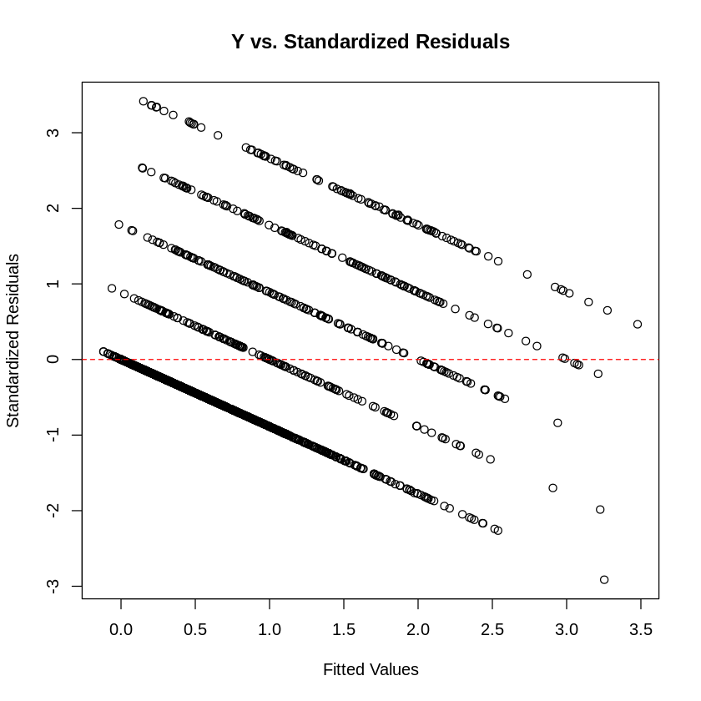
MULITPLE LINEAR REGRESSION
Model 3 Regression Diagnostics
Y versus Standardized Error Terms Scatterplot?
Interpretation Statement The scatterplot does not show a pattern. Y increases as STDE decreases. Most of the STDE terms are between (-2, 2). Hence, this model is NOT a good predictor of Y.

Slide 110
MULITPLE LINEAR REGRESSION MODEL 3 SUMMARY TABLES
TABLE 1: Descriptive Statistics and Bivariate Associations between Alcohol Abuse Risk and Model 3 Risk Factor* among Veterans in The 2022 Military Health and Well-Being Project from ICPSR Michigan (N=1,495)
 | Overall
 | N | Mean (SD) Frequency (%) | Test and p-value
Alcohol and Drug Abuse Risk | 1,495
Combat Exposure(scale) | 1,495 | 11.6 (6.1) | Pearson’s Correlation <0.001
Daily Stress (scale) | 1,495 | 1.6 (1.8) | Pearson’s Correlation = 0.004
Loneliness (scale) | 1,495 | 4.9 (1.9) | Pearson’s Correlation <0.001
Moral Injury (scale) | 1,495 | 40.3 (15.3) | Pearson’s Correlation <0.001
Self-Stigmatization (scale) | 1,495 | 8.8 (5.1) | Pearson’s Correlation = 0.492
Suicide Risk (scale) | 1,495 | 5.3 (3.7) | Pearson’s Correlation = <0.001
History of Traumatic Brain Injury (binary) | 1,495 |  | Pearson’s Correlation = 0.866
No |  | 1243 (83.1%)
Yes |  | 252 (16.9%)
**Denote p value < 0.5
*Combat Exposure, Daily Stress, Loneliness, Moral Injury, Self-Stigmatization, Suicide Risk, and History of Traumatic Brain Injury

Slide 111
MULITPLE LINEAR REGRESSION Summary Tables
TABLE 2: Model 3 Risk Factors* Independently Associated with Alcohol and Drug Abuse Risk using Multiple Linear Regression among Veterans in The 2022 Military Health and Well-Being Project from ICPSR Michigan (N=1,495)
Measures | ß | p-value
Constant | -0.787 |  |  | R= | 0.4913
 |  |  |  | R² = | 0.2414
 |  |  |  | Overall p-value | <0.001
Combat Exposure (scale) | 0.015 | <0.001 | #
Daily Stress (Scale) | 0.121 | 0.004 | #
Loneliness (Scale) | 0.054 | <0.001 | #
Moral Injury (Scale) | 0.014 | <0.001
Self-Stigmatization (Scale) | 0.004 | 0.492
Suicide Risk (Scale) | 0.076 | <0.001 | #
History of Traumatic Brain Injury (Binary) | 0.014 | 0.866
# Denotes p-value < 0.05
*Combat Exposure, Daily Stress, Loneliness, Moral Injury, Self-Stigmatization, Suicide Risk, and History of Traumatic Brain Injury
Notes:
*

Slide 112
MULTIPLE LINEAR REGRESSION
Correlation Plot Between all Protective Factor

Slide 113
MULTIPLE LINEAR REGRESSION
Pearson’s Correlations Between all Protective Factor
 | Alcohol and Drug Use Risk | Help-Seeking Behavior | Quality of Life | Overall Wellness
Alcohol and Drug Use Risk | 1.000
Help-Seeking Behavior | -0.000 | 1.000
Quality of Life | -0.333 | 0.279 | 1.000
Overall Wellness | -0.340 | 0.288 | 0.778 | 1.000

Slide 114
MULTIPLE LINEAR REGRESSION
Dendrogram for Protective Factors
Interpretation Statement The dendrogram suggests there may be collinearity between Quality of Life and Overall Wellness.

Slide 115
MULITPLE LINEAR REGRESSION Summary Tables
TABLE 3: Protective Factors * Independently Associated with Alcohol and Drug Abuse Risk using Multiple Linear Regression among Veterans in The 2022 Military Health and Well-Being Project from ICPSR Michigan (N=1,495)
Measures | Variance Inflation Factors
Help-Seeking Behavior | 1.100
Quality of Life | 2.555
Overall Wellness | 2.569
Interpretation Statement The Variance Inflation Factors (VIF) for the Protective Factors for Alcohol and Drug Abuse are below 5. Therefore, it suggests a moderate or low correlation between predictor variables, indicating that multicollinearity is unlikely to significantly impact the regression model. However, the highest VIF value (3.385) suggests some degree of correlation, but it is still within an acceptable range.
Notes:
*

Slide 116
MULITPLE LINEAR REGRESSION
Model 2 REGRESSION ANALYSIS PROTECTIVE FACTORS
R and R²
Model Summary
Model | R | R Square | Adjusted R Square | Std. Error of the Estimate
1 | 0.3740ª | 0.1399 | 0.1381 | 1.218
a. Predictors: (Constant), Calling and Purpose, Community Engagement, Help-Seeking Behaviors, Military Calling, Quality of Life Score, Public Service Motivation and Wellness
Interpretation Statements There is no correlation between Alcohol and Drug Use and Help-Seeking Behaviors, Quality of Life Score, and Wellness (R = 0.381). 14.1 % of the variance in Alcohol and Drug Use is explained by Calling and Purpose, Community Engagement, Help-Seeking Behaviors, Military Calling, Quality of Life Score, Public Service Motivation, and Wellness.

Slide 117
MULITPLE LINEAR REGRESSION
REGRESSION ANALYSIS
Model 1 Regression Equation with Legend
Equation: Y = 2.999 + + 0.036*X_{P3} – 0.014*X_{P5} – 0.015*X_{P7} + e (no significant change in the model) Legend: Y = Alcohol and Drug Abuse Risk X_{P1} = Calling and Purpose X_{P2} = Community Engagement X_{P3} = Help-Seeking Behavior X_{P4} = Military Calling X_{P5} = Quality of Life X_{P6} = Public Service Motivation X_{P7} = Overall Wellness e = error term
Coefficientsª
Model 2 (Reduced model from saturated Regression to include only those with statistical significance in model 1) |  | Coefficients |  | t | Sig.
 |  | B | Std. Error
1 | (Constant) | 3.3580 | .01921 | 17.480
 | Calling and Purpose
 | Community Engagement
 | Help-Seeking Behavior | 0.036 | 0.008 | 4.614 | <0.001
 | Military Calling
 | Quality of Life Score | -0.014 | 0.003 | -4.894 | <0.001
 | Public Service Motivation
 | Overall Wellness | -0.015 | 0.003 | -5.782 | <0.001
a. Dependent Variable: Alcohol and Drug Abuse

Slide 118
MULITPLE LINEAR REGRESSION
REGRESSION DIAGNOSTICS
Y versus Y –estimate Scatterplot?
Interpretation Statement There is no strong positive linear pattern. Hence, this model is NOT a good predictor of Y.

Slide 119
MULITPLE LINEAR REGRESSION
REGRESSION DIAGNOSTICS
Standardized Error Terms Histogram
Interpretation Statement Error terms are small. The mean is close to 0, with most values are between -2 and 2. The histogram for the STDE is not bell-shaped and symmetric. Therefore, this model is NOT a good predictor of Y.

Slide 120
MULITPLE LOGISTIC REGRESSION Summary Tables
TABLE 1: Descriptive Statistics and Bivariate Associations between Alcohol Abuse Risk and Risk Factors* among Veterans in The 2022 Military Health and Well-Being Project from ICPSR Michigan (N=1,495)
 |  |  | Alcohol Abuse Risk
 | Overall |  | No Risk |  | At Risk
 |  | Mean (SD) |  | Mean (SD) |  | Mean (SD)
 | N | Freq (%) | N | Freq (%) | N | Freq (%) | test and p-value
Alcohol Abuse RIsk | 1,495
No Risk |  | 1,104 (71.8%)
At Risk |  | 391 (26.2%)
Calling and Purpose (scale) | 1,495 | 20.2 (3.2) |  | 20.3 (3.1) |  | 20.1 (3.4) | Mann-Whitney p-value = 0.587
Community Engagement (scale) | 1,495 | 26.6 (5.2) |  | 27.3 (5.0) |  | 24.9 (5.2) | Mann-Whitney p-value <0.001**
Help-Seeking Behavior (scale) | 1,495 | 13.0 (4.3) |  | 13.0 (4.3) |  | 12.9 (4.4) | Mann-Whitney p-value = 0.906
Military Calling (scale) | 1,495 | 17.4 (3.7) |  | 17.5 (3.6) |  | 17.0 (3.8) | Mann-Whitney p-value = 0.002**
Quality of Life | 1,495 |  |  |  |  |  | Pearson Chi-Square test p-value <0.001*
Very Poor |  | 19 (1.3%) |  | 11 (0.7%) |  | 8 (0.5%)
Poor |  | 90 (6.0%) |  | 36 (2.4%) |  | 54 (3.6%)
Neither poor or good |  | 226 (15.1%) |  | 130 (8.7%) |  | 96 (6.4%)
Good |  | 762 (51.0%) |  | 588 (39.3%) |  | 174 (11.6%)
Very Good |  | 398 (26.6%) |  | 339 (22.7%) |  | 59 (3.9%)
Public Service Motivation (scale) | 1,495 | 20.0 (3.4) |  | 20.0 (3.4) |  | 19.9 (3.4) | Mann-Whitney p-value = 0.838
Wellness (scale) | 1,495 | 19.0 (3.5) |  | 19.7 (3.4) |  | 17.2 (3.1) | Mann-Whitney p-value <0.001**
**Denote p value < 0.5
*Combat Exposure, Daily Stress Status, Loneliness Level, Degree of Moral Injury, Self-Stigmatization Level, Suicide Risk Status, and History of Traumatic Brain Injury

Slide 121
MULITPLE LOGISTIC REGRESSION Summary Tables
TABLE 2: Risk Factors Independently Associated with Alcohol Abuse Risk using Multiple Logistic Regression among veterans in 2022 The Military Health and Well-Being Project from ICPSR Michigan (N=1,495)
Measures | ß | p-value
Constant | -2.810 |  |  | % correctly predicted:
 |  |  |  | Overall p-value < | 0.175
Combat Exposure | 0.187 | 0.167
Daily Stress Status | 0.562 | 0.157
Loneliness
Military Calling | -0.046 | 0.021*
Quality of Life
Very poor | ref
Poor | 0.805 | 0.525
Neither poor nor good | 0.346 | 0.500
Good | -0.138 | 0.495
Very good | -0.181 | 0.523
Public Service Motivation | 0.042 | 0.027*
Wellness | -0.214 | 0.297
*Denote p-value < 0.05
Notes:
0.562*

Slide 122

Thank You Questions
Herzliya, Israel Overlooking the Mediterranean Sea, October 30, 2008

